Slide 1


Independent Evaluation and Audit Services (IEAS)
Independent Evaluation Service (IES)
CORPORATE EVALUATION OF UN WOMEN’S CONTRIBUTION TO
HUMANITARIAN ACTION
August 2019

Slide 2
WHAT WAS EVALUATED
The evaluation focused on UN Women’s work in humanitarian action from 2014-2018.
The evaluation assessed the relevance, appropriateness, effectiveness, efficiency,
connectedness and sustainability of UN Women’s approach to humanitarian action at global, regional and country level.
The annual budget for UN Women’s humanitarian work grew from USD 3.4 million in
2011 in 4 countries to USD 27.2 million in 2017 in 43 countries. 95% of the funding under scope of this evaluation was non core.

Slide 3
HOW THE EVALUATION WAS CONDUCTED
5 country visits (Cameroon, Bangladesh, Colombia, South Sudan and Jordan) + New York & Geneva
Formative evaluation
461 semi-structured interviews
23 Focus Group Discussions
Extensive portfolio
review (39 countries)
Self-assessment
questionnaire (6 regional humanitarian advisors)
Utilization-focused evaluation
Over 550 documents reviewed
Survey with 221
responses (33% response rate)

Slide 4
POSITIONING AND PRIORITIZATION
CONCLUSION 1
CONCLUSION 2
UN Women helps to ensure that gender equality and
the empowerment of
women remains central to humanitarian action.
Stronger links are needed
between UN Women’s
global normative work and humanitarian coordination mechanisms where
needs and priorities are determined.

Slide 5
FOCUS AND PARTNERSHIPS
CONCLUSION 3
CONCLUSION 4
UN-Women should continue to build on its
“development” work while increasing its focus on the “humanitarian” side of the nexus.
Working in partnership can ensure that UN-Women makes contributions at
sufficient scale while
increasing opportunities for funding.

Slide 6
LEARNING FROM RESULTS
CONCLUSION 5
CONCLUSION 6
Lessons from UN-Women’s country level work
should serve to improve programming approaches
globally and serve as a catalyst for longer-term transformative change.
There is significant
evidence that UN-Women has been highly effective in its global normative
work.

Slide 7
HUMAN AND FINANCIAL SYSTEMS/GENDER EQUALITY AND HUMAN RIGHTS
CONCLUSION 7
CONCLUSION 8
UN-Women’s reliance on non-core resources tends to make it more
reactive and less strategic, and thus less efficient overall.
UN-Women’s capacity and expertise
in humanitarian action vary across offices, risking UN-Women’s ability to
deliver consistently.
CONCLUSION 9
UN-Women’s work exemplifies gender equality and human rights approaches.

Slide 8

RECOMMENDATIONS
Develop a response- level strategy to
complement UN Women’s global humanitarian
strategy.
Identify necessary
leadership, minimum levels of staffing and office structures for a
response-level strategy in humanitarian
settings.
Develop global
partnership frameworks with OCHA, UNHCR
and UNFPA building on experience in
partnerships in different contexts.
Increase effectiveness and impact in
humanitarian action by better linking
UN Women’s work to system-wide
responses.

Slide 9



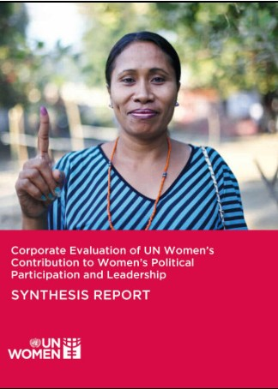

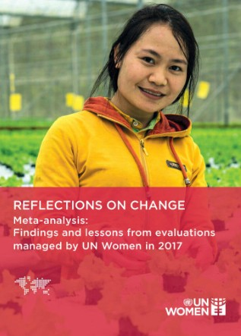






Independent Evaluation and Audit Services (IEAS)
Independent Evaluation Service (IES)
THANK YOU
Find all corporate evaluations at:
http://www.unwomen.org/en/about-us/accountability/evaluation/corporate-evaluations
CORPORATE THEMATIC EVALUATION OF UN WOMEN’S CONTRIBUTION TO
GOVERNANCE AND NATIONAL PLANNING
Final Report
CORPORATE THEMATIC EVALUATION OF UN WOMEN’S CONTRIBUTION TO
GOVERNANCE AND NATIONAL PLANNING
Final Report
CORPORATE THEMATIC EVALUATION OF UN WOMEN’S CONTRIBUTION TO
GOVERNANCE AND NATIONAL PLANNING
Final Report
CORPORATE THEMATIC EVALUATION OF UN WOMEN’S CONTRIBUTION TO
GOVERNANCE AND NATIONAL PLANNING
Final Report
Find us on Twitter
@unwomenEval

