Slide 1

Achieving concrete & sustainable transformation in the lives of women and girls by supporting relevant actors to address the root causes of gender inequality and building capacity for resilience
UN WOMEN
EAST & SOUTHERN AFRICA REGION
Maxime Houinato
Regional Director

Slide 2
ESAR - Regional Context
Shrinking democratic space for civil society; electoral violence
Uneven women’s representation ranging from 9% (Eswatini) to 45% (SA) and 61% (Rwanda)
Despite gains in political participation, women are denied access to the corridors of power
POLITICAL & CONFLICT
Conflict, natural disaster and state fragility (Sudan, Ethiopia, Mozambique, Eswatini, Somalia)
Refugee & humanitarian crisis (region hosts 67% of continent’s refugees)
Internal displacement of women & children (about 10 million IDPs)
HUMANITARIAN CRISES
Two thirds of women in informal sector (cross border trading; small scale agricultural activities)
Decline in agricultural productivity and weakened supply chain
Roll out of the AfCFTA potential economic boon for women traders
Food & Fuel crisis (Ukraine)
ECONOMIC & UKRAINE
Economic growth contracted from 2.4% in 2019 to between -2.1% & - 5.1 % in 2020 and deepened poverty – Further deterioration due to Ukraine War
Impacting 63% females, leading to increased job losses and more unpaid care work
Spike in GBV (teenage pregnancy, child marriage, child labor, FGM, domestic violence)
COVID-19

Slide 3

2018-2021
ACHIEVING RESULTS ALONG
UNW’s TRIPLE MANDATE
Prog Planning
& Res. Mobilization
Communication & Quality Reporting
Prog Implementation Impact And M&E
Budget, Finance, Procurement & HR
EAST & SOUTHERN REGION
Capacity Dev for Self, Team and Partners
IT and Security Management
OPERATIONAL
Outcomes & Outputs in UNSD-CF
Gender Accounty. for the UN & Donors
Active UN Gender Working Groups
Policy Directions & Advocacy for the UN
COORDINATION
Gender Knowledge Generation in UN
UNW Leadership in UN Joint Progs
Culture; Traditions
& Beliefs
Gov. International Commitments
NORMATIVE
Laws; Policies; Gov./Pub Procedures
Gov. Conventions & Reporting Obligations

Slide 4
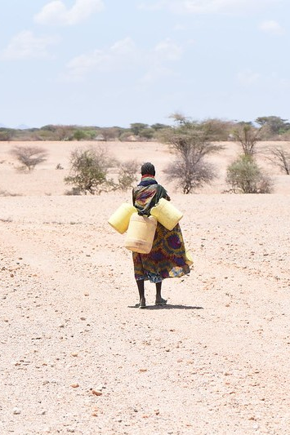
What Has Changed (Beyond Projects) In 2018-2021
Transformative Change #1
Increased voice
Economy: Women in policy making (Chamber of Com & Agric)
Social: VAW Survivors/PLWHIV/PLW-Disabilities
Political: Stronger Women’s Movt; Common CSOs Agenda
Traditional: Progress on social/gender norms (AWLN/COTLA)
NB: Recent shrinking of political space in several countries
Transformative Change #2
Increased Agency/Skills
Climate: Technical capacity increased in 8 Countries
Business: Access to resources (info, finances,) & markets
Humanitarian & Conflict: Mediation in crisis, Advocacy
Building Resilience
Notes:
This slide should present a summary of some key results – does not have to be cumulative but longer-term investments and achievements can be reflected here. This is in anticipation of the presentation of the EDAR at the next formal session of the Executive Board.

Slide 5
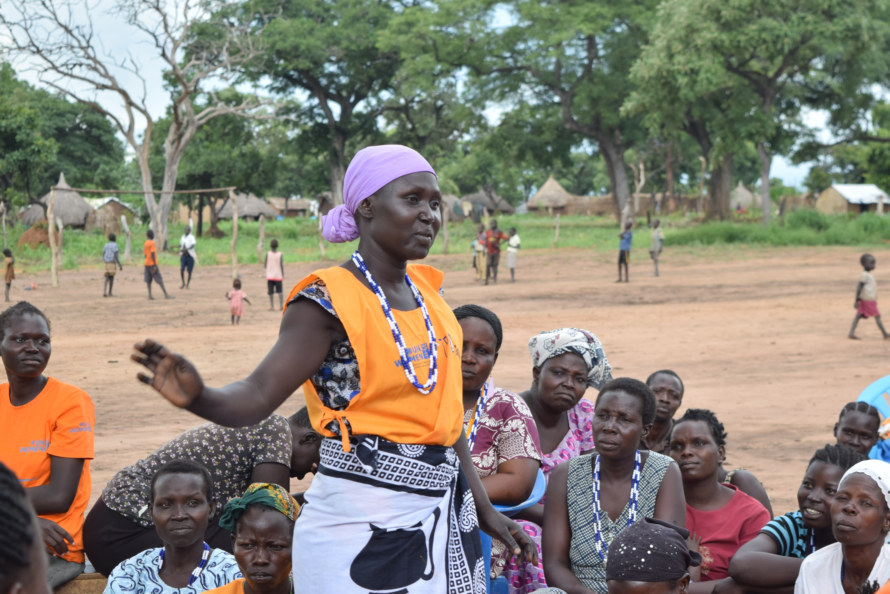
What Has Changed (Beyond Projects) In 2018-2021
Transformative Change #3
Improved Legal Environment
Governance: Women Representation laws
VAW: Protection laws, implementation guidance
Land & Inheritance: Marriage & divorce acts
NB: Implementation patchy and now our focus
Transformative Change #4
More Accountable Governments
International: Reporting Systems (CSW, CEDAW, UPR)
National: Gender Monitors (UGA, RWA, BUR, KEN)
Local: Gender & Decentralization (SDG, R1325)
Participating in Policy Making
Notes:
This slide should present a summary of some key results – does not have to be cumulative but longer-term investments and achievements can be reflected here. This is in anticipation of the presentation of the EDAR at the next formal session of the Executive Board.

Slide 6
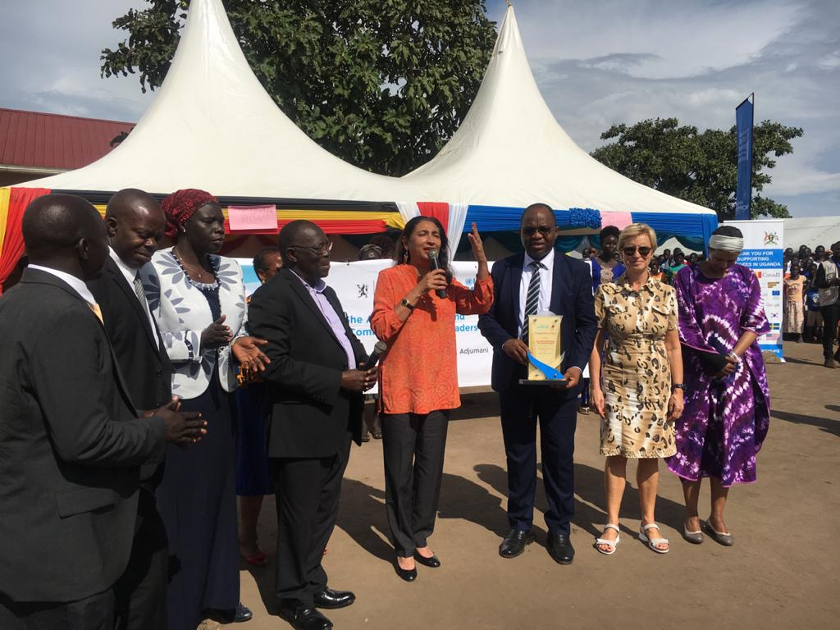
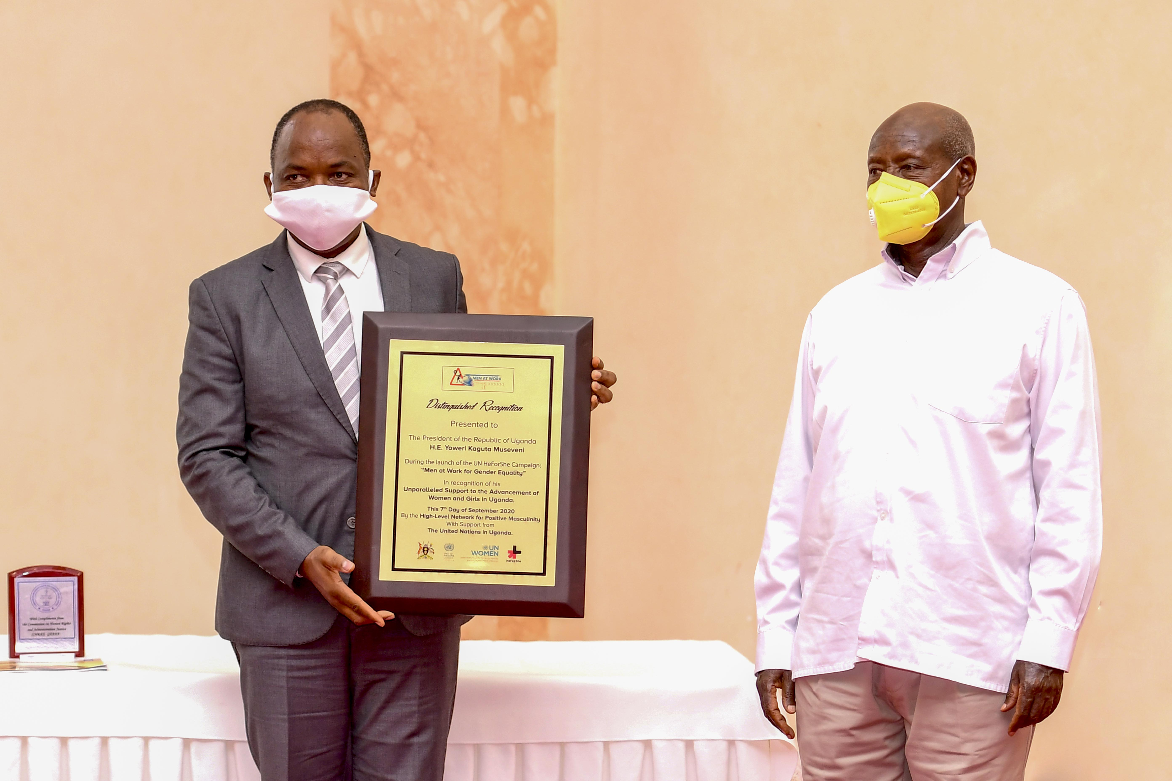
What Has Changed (Beyond Projects) In 2018-2021
DED, NORWAY, HCR & GoU ON
WOMEN REFUGEES REPRESENTATION
“MEN @ WORK FOR GENDER EQUALITY”
ACKNOWLEDGING PROGRESS…
We have succeeded in encouraging & rewarding decision makers to personally commit to (& deliver on) gender equality and positive masculinity

Slide 7
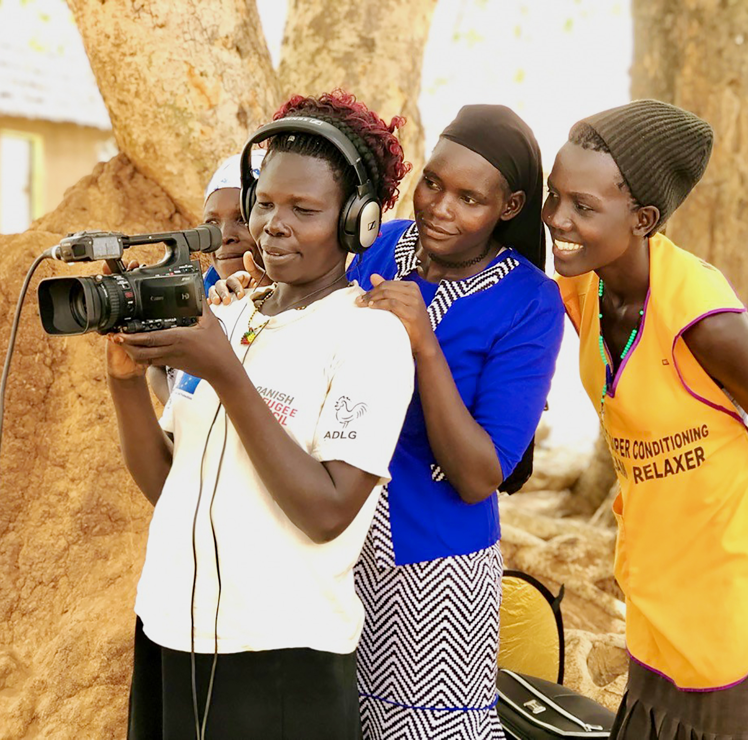
Advancing UN Coordination
Coordination Workstream #1
UN Gender Accountability
Application of UN accountability frameworks for GEEW (Gender Scorecard; Gender Swap; Gender Marker)
Improved gender balance and the status of women in the UN System (Gender Parity; Women security)
Gender in RCs’ workplans, with UNW/RD Appraisal
Coordination Workstream #2
Gender in UN Strategic Plans
50% of UNSDCF with Gender Outcome; 100% mainstreamed
80% of CCAs with strong Gender Analysis
GEWE mainstreamed into key interagency decision-making
Women’s Movement; CSOs, strategically involved in UN Planning
UN & Youth: Tell your own story
Notes:
This is a priority area for the ED and for many Board members. This can reflect UNW leadership at regional and country levels of inter-agency mechanisms, joint programming, etc

Slide 8
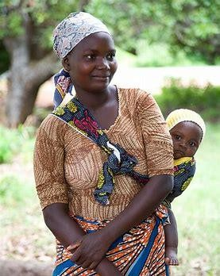
Advancing UN Coordination
Coordination Workstream #3
UN Gender Capacity Building
System-wide gender mainstreaming increased
Engendered OIBCs and Peer Support Group (RDT)
Strengthened normative commitments such as SDGs, BPfA, CEDAW and CSW
Coordination Workstream #4
UNW Strategic Positioning
UN Partnerships strengthened: 60% of budget in 6 COs
UN Effectively engaged in GEF and Action Coalitions
Successful linkage & framing of “LNOB” principle within the UN Gender Equality priorities.
LNOB Within GEWE Priorities
Notes:
This is a priority area for the ED and for many Board members. This can reflect UNW leadership at regional and country levels of inter-agency mechanisms, joint programming, etc

Slide 9
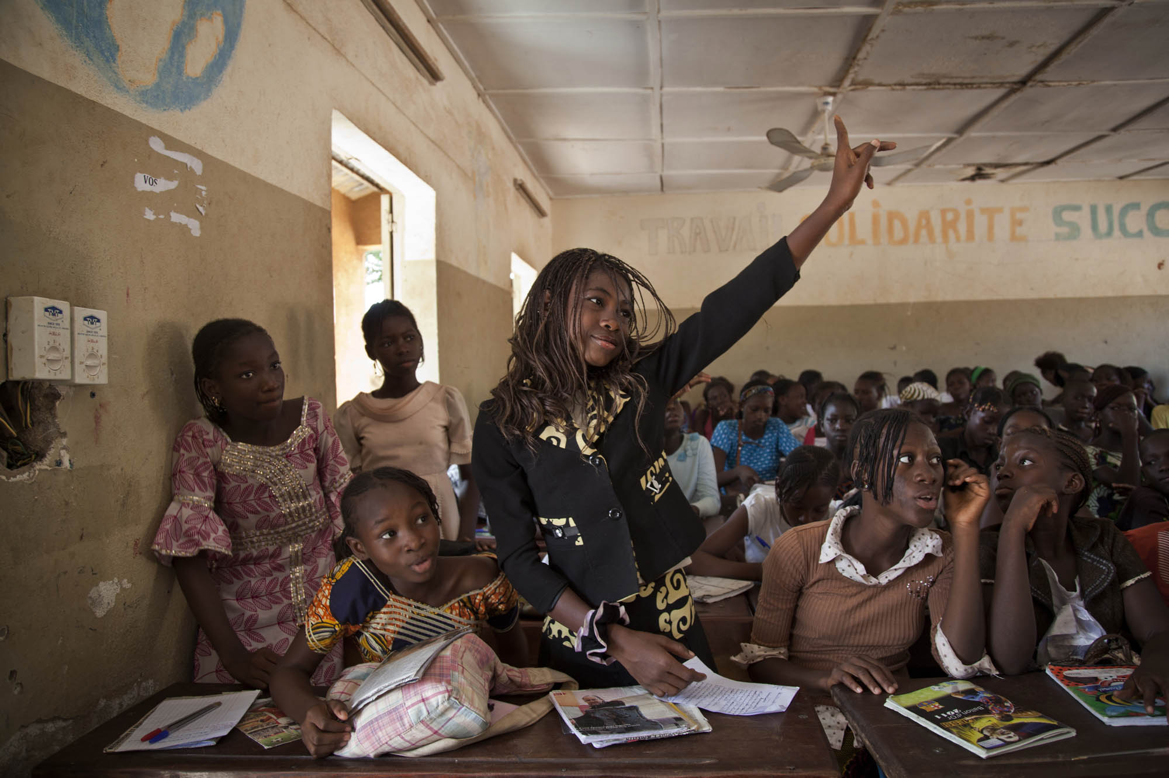
Civil Society Perspectives – Six (6) Areas of Success
Understanding: Regional Study in 10 COs
Micro-Macro Linkage: Local to National
Broadening Scope: Youth; Faith; Traditional
Institutionalization: Governance
Technical Capacity: Advocacy & Policy
Political Awareness: Feminism & Rights
1
2
3
4
5
6

Slide 10
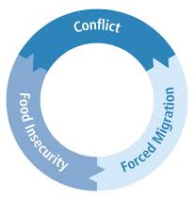
Zoom # 1: The DEV., CONF. & HUM. Nexus
COVID -19
TOTAL CASES: 5,395,571
DEATHS: 129,023
(13 COs With UNW PRESENCE)
DROUGHT/FOOD INSECURITY:
41 M- total
(20m Horn of Africa; 21m Southern Africa )
CONFLICT/REFUGEE/INTERNAL DISPLACEMENT:
(5M REFUGESS & 14M idpS)
Conflict-forced migration-food insecurity nexus

Slide 11
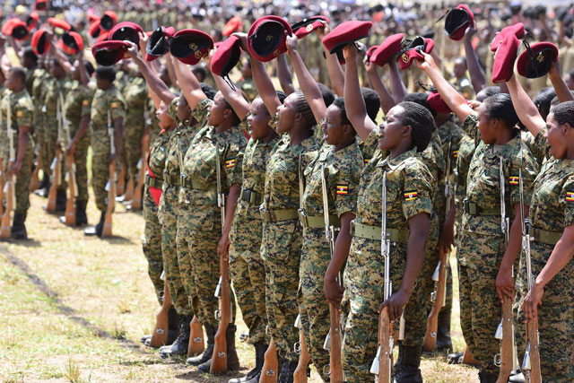
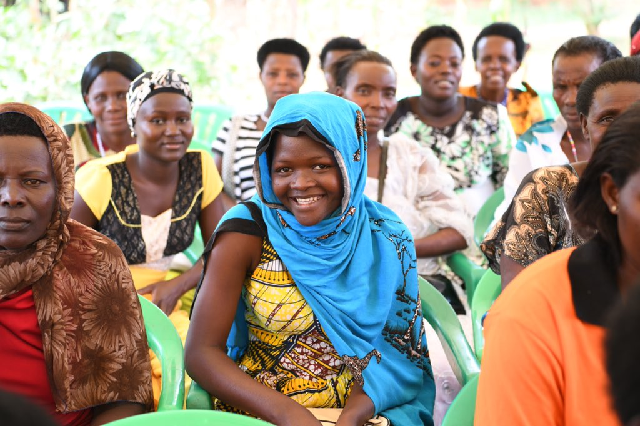
Zoom # 1: Continued
Context: Region with conflicts and disaster with 15m refugees in Uganda alone
Instruments: LEAP; NAP1325; DRR
Results: Gender Accountability in UN & Government Response; Effective Women Leadership; Increased Resilience.
Beneficiaries = 1.5 million women
Country Cluster: Uganda, Somalia; Ethiopia; South Sudan; Sudan; Burundi
Donors: UN; Japan; Norway; Sweden
Notes:
This slide can be used to share a great example that shows UN Women pogramming excellence and how this has led to a significant result or set of results. Ideally, this is an example that may be replicable in other regions.

Slide 12
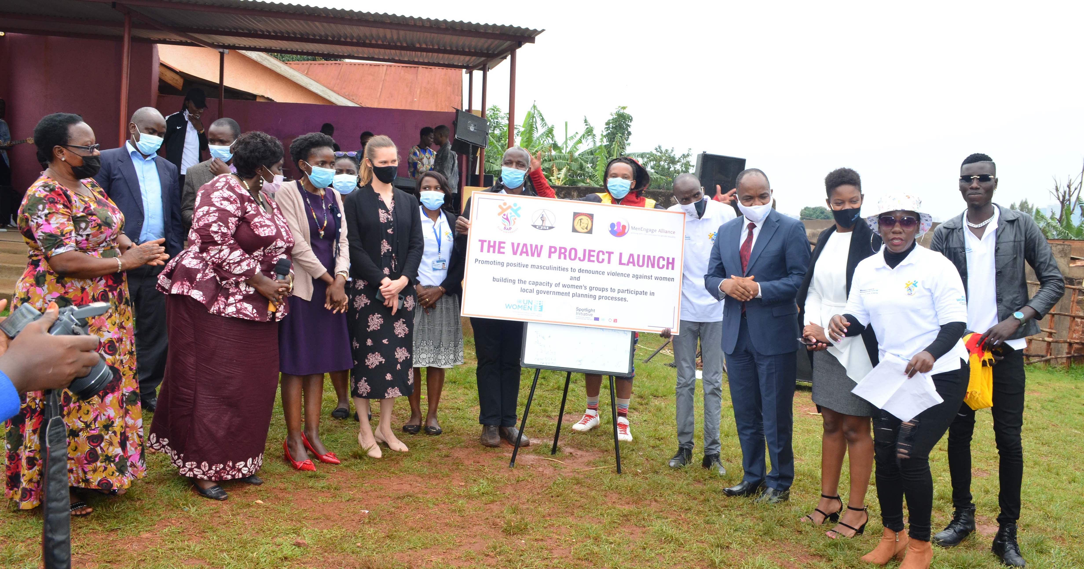
Zoom #1: Continued…
Support to VAW Survivors

Slide 13
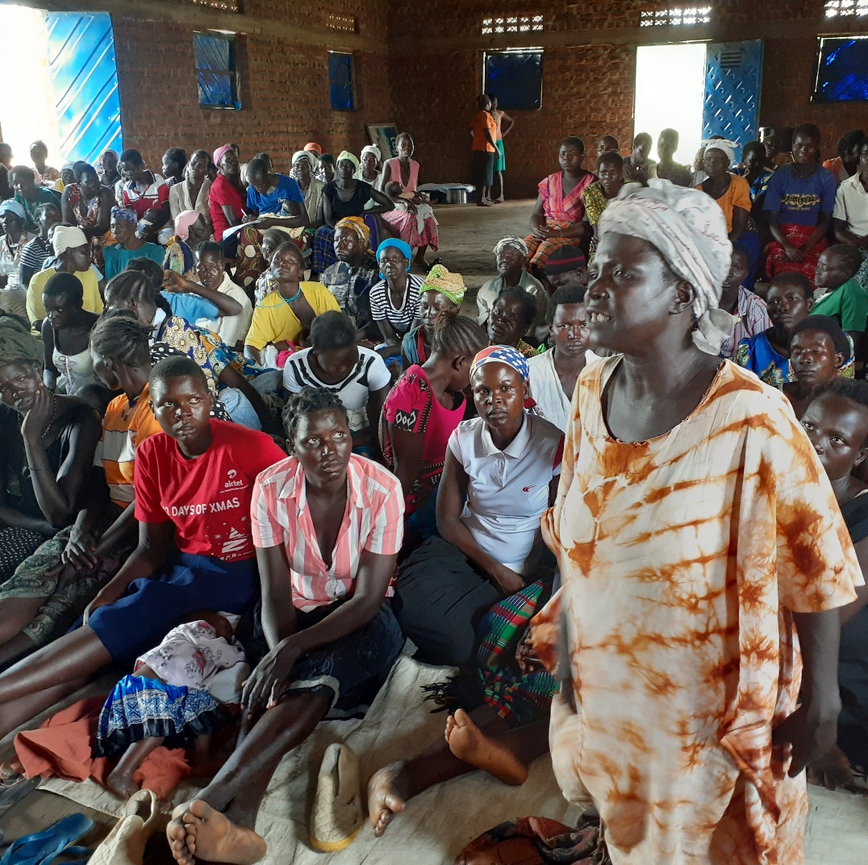
“Our voice will never be shut down again
- even as we found ourselves in precarious situations mostly created
by men”

Slide 14
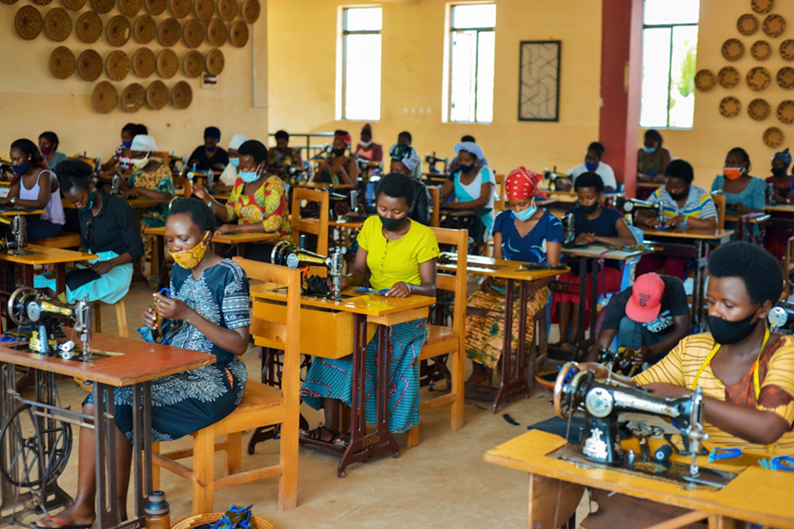
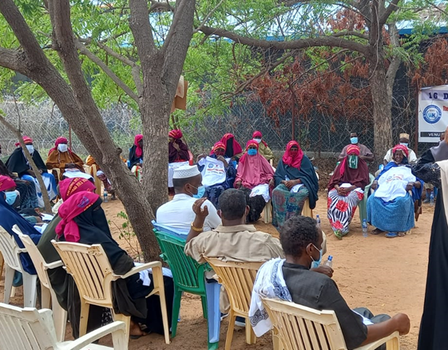
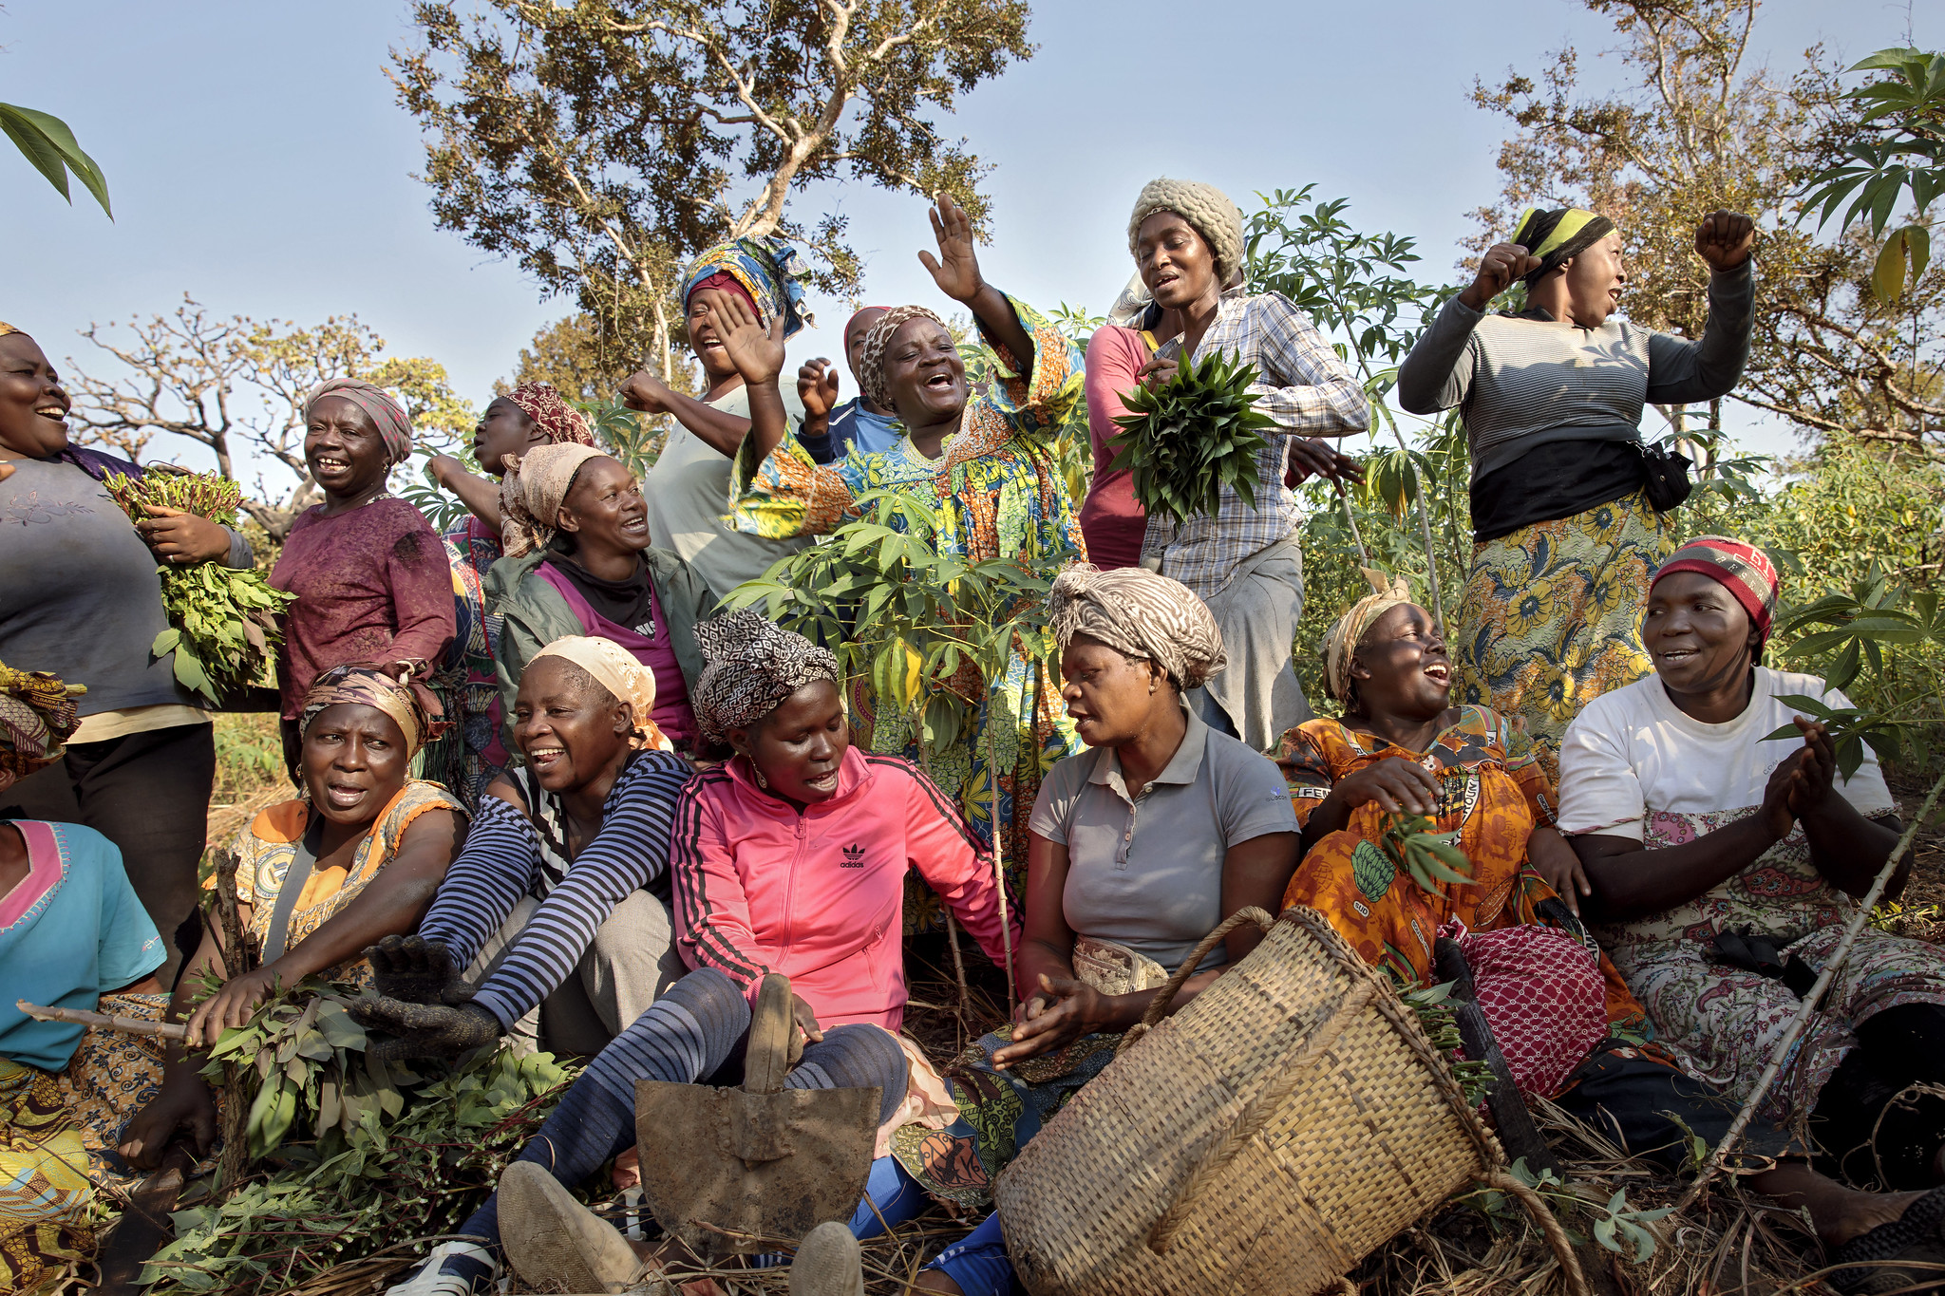
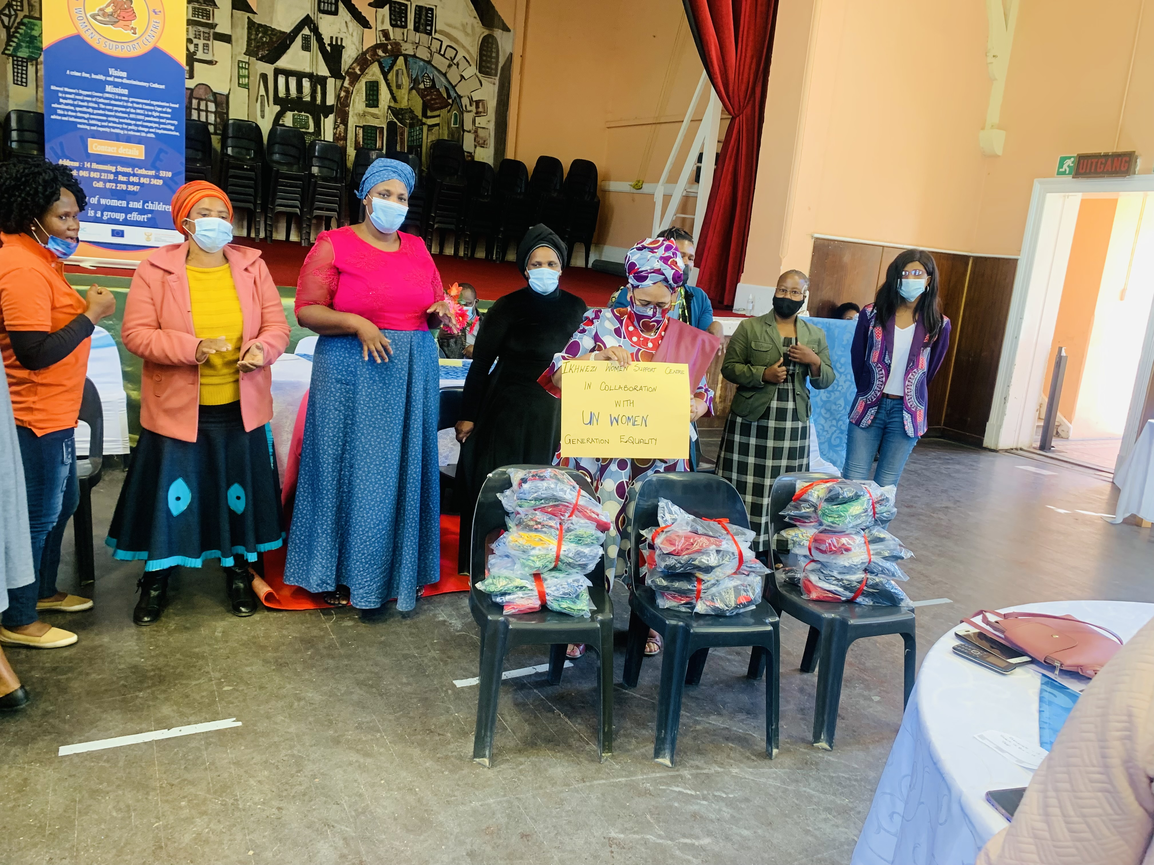
As a result, More than 500,000 women are now able to prevent, mediate, mitigate, advocate, protect, participate, or recover, in contexts of conflict or disaster
Zoom #1: Continued…

Slide 15
SUPPORT FOR VERTICAL
& STRATEGIC ALIGNMENT
Micro-Macro Approach to success
CEDAW & BPoA
UN/R 1325
AU AGENDA 2063
SDG
R1325 NAP DEV PLAN
MAP. PROTOCOL
Global Advocacy
Efforts to ensure that DRR & R1325 Actions & Priorities in Countries benefit from and are Supported by global Processes and the International Community
TRAD. JUSTICE POL
REG AP FOR R1325
CONF RES CULTURE
LAND POLICY & DRR
Regional Integration & Learning
Sharing R1325 & DRR Experiences in the Sub Regions
(E.G. GREAT LAKES & HORN OF AFRICA)
DEC & LOC DEV LAWS
UN SD COOP FRAMW
COM DEV POLICIES
Nat. Advocacy on Policies and Norms
Support to Women for Political influence and Social Transformation in line with the R1325 NAP and DRR Outcomes
LOCAL DEV PLANS
GLOBAL
Community Anchoring
– NAP 1325 Actions on the Ground – Local Dialogue for Social Cohesion – Leadership & Capacity
REGIONAL
NATIONAL
LOCAL
Zoom #1: Continued…

Slide 16
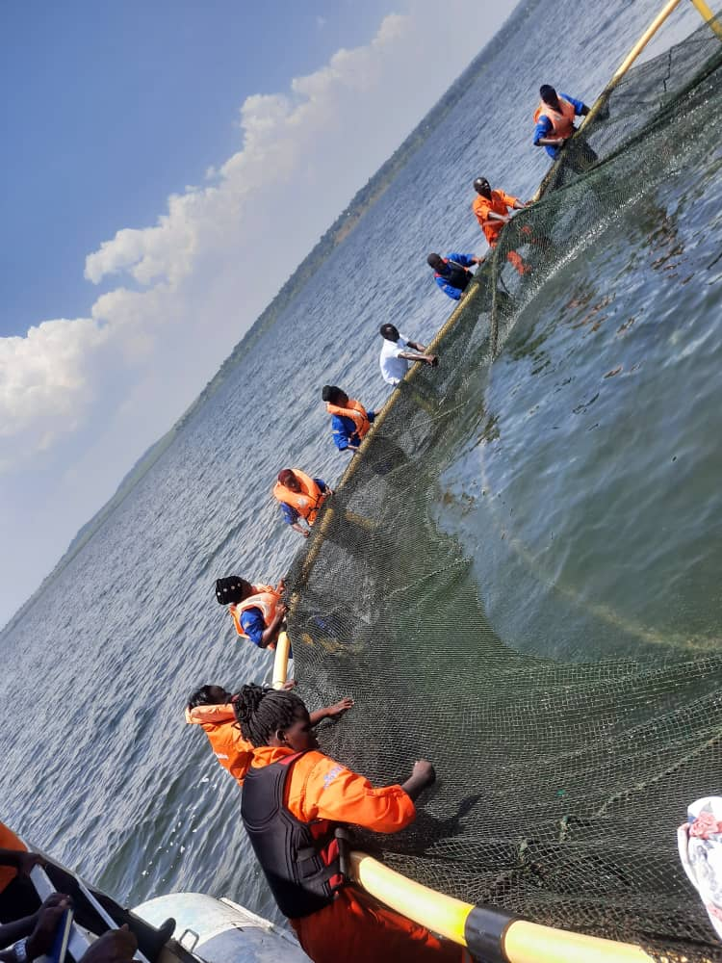
Zoom # 2: Climate Smart Agriculture (CSA)
Context: Region with high levels of rain in many countries and several lakes - but facing food shortage
Instruments: CSA; Business Development; Market access; Financing; Technology; Food systems Integration
Selected Results: See Next Slide.
Beneficiaries = 50.000 women
Country Cluster: Uganda, Kenya, Ethiopia, Malawi, South Africa
Donors: Stambic Bank; Norway; Sweden
Income Generation in Great Lake Region
Notes:
This slide can be used to share a great example that shows UN Women pogramming excellence and how this has led to a significant result or set of results. Ideally, this is an example that may be replicable in other regions.

Slide 17
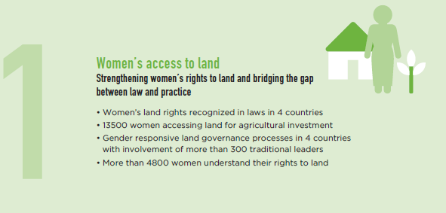
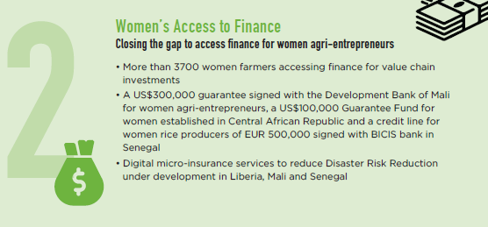
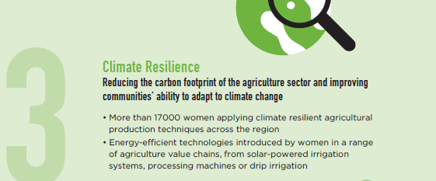
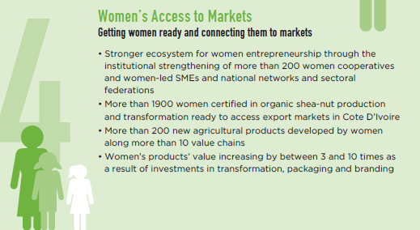
CSA. Four (4) Areas of Success
Access to land
Finances
Over 20,000 women able to access finance in Burundi, Ethiopia, Kenya, Malawi, Mozambique
Over 150 Village savings & loan associations formed and supported in Malawi, Sudan and Rwanda
1800 women SMEs with grants and 1000 access low interest loans in Kenya
Mapping of land rights laws and discriminatory policies in Malawi
Capacity building on land rights in Tanzania and Malawi
Evidence-based analysis on gender and environmental to provide guidance on closing the gender gap
Markets
Technology
Aggregation of farmers produce: Women produce approximately 225,000 MT, worth USD 449,393 of Groundnuts in Malawi, in Uganda 1400 women organized into 14 clusters with 100 members each for fish marketing
Value addition: Using labor saving technologies 4,033 women in Malawi (Strippers and Shellers) reduced post harvest losses. 1,400 women in Uganda used cold fish storage facilitates
Over 80,000 benefited from CSA technologies including improved seed, fish farming, poultry, solar energy from Ethiopia, Malawi, Mozambique, Somalia, South Africa
Zoom #2: Continued…

Slide 18
LOOKING AHEAD – IMPLEMENTING UNW’s 2022-2025 SP IN ESAR
Systemic change (accountability for financing and implementation of GEWE commitments
Relational level change (safe spaces and convening platforms to coalesce rights holders)
Social and cultural change (transform harmful behaviors and practices)
Knowledge for change (using gender data analysis for better action and results)
Peer influence change (UN coordination bodies and mechanisms advance GEWE accountability)
Women and girls are safe, their voices
heard and they can make informed choices
THEN
The RO will contribute to
IF
Regional entities advance women’s human rights, reduce patriarchal barriers of discrimination and create equal opportunities for women & girls

Slide 19

UNW ESAR IN 2022-2025
ESARO Goal
SN Impact
SN Outcomes
IMPACT 1
Governance &
Participation in
Public Life
IMPACT 2
Women’s
Economic
Empowerment
IMPACT 3
Ending Violence
Against Women
IMPACT 4
Women, Peace & Security,
Humanitarian
Action, & Disaster
Risk Reduction
Regional actors challenge stereotypes
Women and girls are safe, their voices
heard and make informed choices
1
Women’s movements hold duty-bearers accountable
A catalyst for accelerating change on Gender Equality across the ESA region
Member States are accountable for GEWE commitments
Regional entities advance women’s human rights, reduce patriarchal barriers of discrimination and create equal opportunities for women and girls in their diversity
2
Gender data and knowledge products deliver GEWE results in ESA
UN System Coordination to advance in ESA region
AFRICA STRATEGY 2.0 – STRATEGIC PARTNERSHIPS (COTLA – AWLN – FORUM FOR POSITIVE MASCULINITY – AU/LO in ADDIS)

Slide 20
APPROACH TO IMPLEMENTATION
TECHNICAL & ADVISORY
SUPPORT
GENERATE KNOWLEDGE,
DATA & EVIDENCE
ADVOCACY
AND
COMMUNICATIONS
DEEPENING PARTNERSHIPS
& RM
Capacity building for Member States, Women’s Movements, UNCTs
Influencing IFIs to integrate gender
Supporting COs to deliver AWPs
Diversifying and strengthening regional partnerships
Cultivating new regional donors
Develop regional joint programmes
Inform frameworks and standards for gender data
Build stakeholder capacity for gender data and analysis
Generating knowledge on GEWE
Sharing promising practices & learning
Evidence-based policies and programmes
Create safe spaces for diverse gender advocates

Slide 21
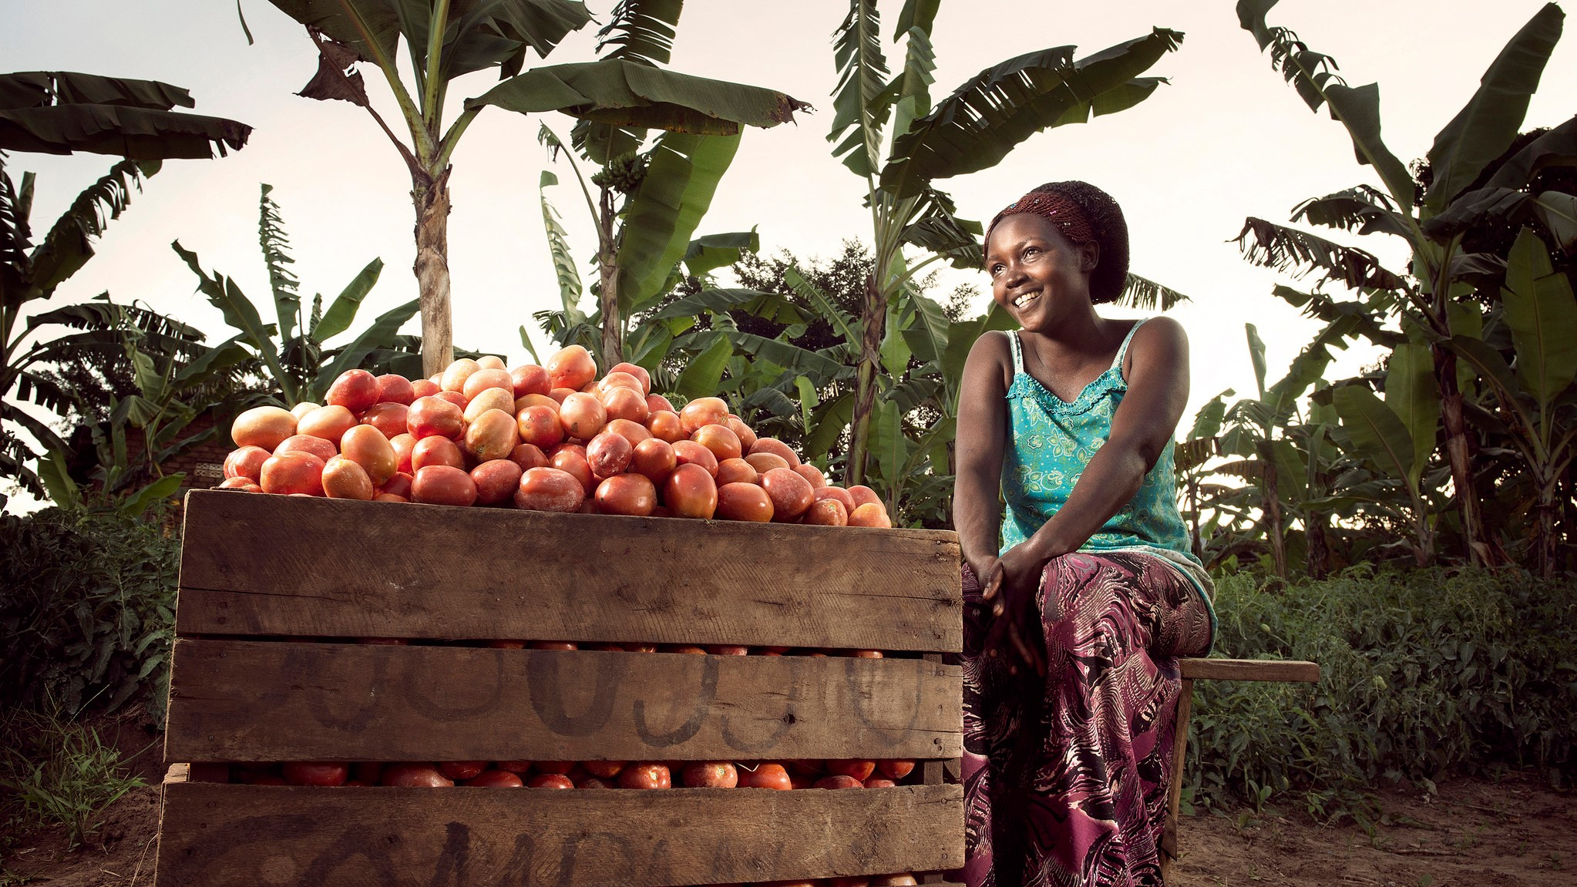

THANK YOU FOR
YOUR KIND ATTENTION

