Slide 1
UN-Women Executive Board Second Regular Session 2023 ​12-13 September 2023; CR-3, United Nations HQ
Second Regular Session 12-13 September 2023;
CR-3,
United Nations HQ
Documentation
Agenda
Logistics

Slide 2
UN-Women Executive Board Second Regular Session 2023 12-13 September 2023; CR-3, United Nations HQ

Slide 3
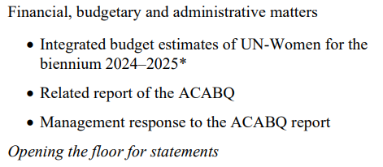
UN-Women Executive Board Second Regular Session 2023 12-13 September 2023; CR-3, United Nations HQ

Slide 4
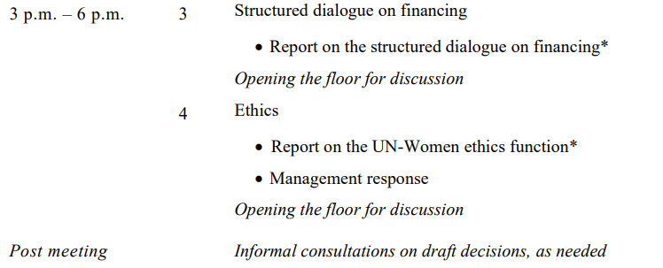
UN-Women Executive Board Second Regular Session 2023 12-13 September 2023; CR-3, United Nations HQ

Slide 5
UN-Women Executive Board Second Regular Session 2023 12-13 September 2023; CR-3, United Nations HQ

Slide 6
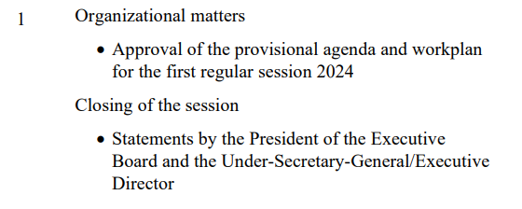
UN-Women Executive Board Second Regular Session 2023 12-13 September 2023; CR-3, United Nations HQ

Slide 7
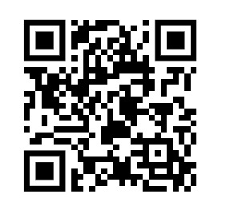
UN-Women Executive Board Second Regular Session 2023 12-13 September 2023; CR-3, United Nations HQ
Please follow us @unwomenboard for the latest information on the Executive Board activities!

Slide 8
UN-Women Executive Board​ Second Regular Session 2023​ 12-13 September 2023; CR-3, United Nations HQ​
Logistics
Time limits: 3 minutes for individuals, 5 minutes for groups
All negotiations chaired by facilitators. Shared screen used.
 Interpretation into all the official languages
 Protocol will be followed. Please adhere to time limits.
 Schedule of negotiations and latest compilation of decisions circulated before each negotiation.
 Negotiations will occur back-to-back.
Statements to eStatements@un.org
Decisions will be adopted in the plenary room.
For more info, please visit the Second Regular Session page of the UN-Women Executive Board website: ​
https://www.unwomen.org/en/executive-board/documents/2023/second-regular-session-2023

