Slide 1
Participation and multi-stakeholder partnerships for gender-responsive implementation of 2030 Agenda
Thursday 17 March 2016
Official Event
Hon. Olfa Soukri Cherif

Slide 2


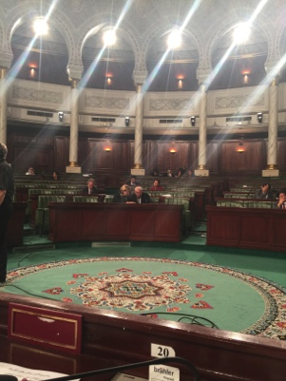
Constitution

Slide 3
Article 21
Men and women are equal
No discrimination by gender
Article 34
Representation of women in assembly
Article 46
Protect and strengthen women’s rights

Slide 4
Political Rights
Possibility for women to be president
Gender parity in elected assemblies

Slide 5
INTERNATIONAL CONVENTION

Slide 6
CEDAW
Tunisia has officially lifted key reservations to the international women’s treaty – an important step toward realizing gender equality

Slide 7
Labor Rights

Slide 8
Constitution
  Right to work
  Equal wage

Slide 9
Labour Code
No discrimination against women
International Convention
ILO Convention No. 100: concerning Equal Remuneration for Men and Women Workers for Work of Equal Value

Slide 10
Paradoxes

Slide 11
Gender equality in politics
  34% members of parliament are women
  3 women ministers (10%)
  0 women governors

Slide 12
Gender Equality
  Even though 2 out of 3 graduates are women,
  the unemployment rate of women graduates is almost double than men
  Men 22%
  Women 42%

Slide 13
Challenges

Slide 14
Parliament

Slide 15

No economic exploitation of women
the adoption of the draft law against human trafficking, domestic servitude and all other forms of economic exploitation of women and girls.
ratified

Slide 16

Ending violence against women
A draft law on violence against women

Slide 17
Political rights

Slide 18
Electoral Law
  Parity at the vertical level and at horizonal level
  50-50

Slide 19
Gender Approach in economic laws

Slide 20
Gender budgeting
The gender approach in the budget law

Slide 21
Entrepreneurship and Investment
implementing regulations for investment incentives for women entrepreneurs

Slide 22
Government

Slide 23
Parity
  in all instances of decision making, especially in the government and in all public institutions
  in constitutional bodies whose creation is in progress:
      The Higher Judicial Council
      The Constitutional Court
      The Forum of Human Rights
      The Forum of Audiovisual Communication
      The Forum of Sustainable Development and Protection of Future Generations
      the instance of good governance

Slide 24
Multi-stakeholder Partnerships to achieve SDGs

Slide 25
Participatory democracy approach
organizing at city and local governments to ensure the participation of all women and girls as active member in the implementation of gender equality

Slide 26
Governments
National gender equality mechanisms across government support the effective integration of gender equality :
at political level : the municipal level to achieve gender equality and women’s empowerment
At the economic level: empowerment of women
At the labor level: reach the objective of 35%of women participation in active population by 2020

Slide 27
Parliament
The gender equality objectives have to be reflected in national development plan in harmony with the implementation of the 2030 Agenda to achieve SDGs

Slide 28
Multilateral Development Bank
Data collection and research with gender lens;
Information and business support services of women
access to credit and financial services for women.

Slide 29
Women’s civil society organizations and networks
Lead public consultation with girls and women
Empowering women
Support women candidate to run for municipal elections
Lead actions in rural areas
Help ensure the full and effective participation and leadership of women and girls

Slide 30


SDGs
People Partnership
Planet Prosperity Peace

Slide 31

Merci Thank you شكرا

