Slide 1


The Arab Republic of Egypt
CSW60 , New York
15th of March 2016

Slide 2
Legal Framework
Criminalization of VAW&G according to Article 11 Constitution 2014 “Protection from all forms of Violence Against Women”
Criminalization of FGM by Law 2008 and 7 years later in 2015, for the first time, a doctor was convicted of FGM and was sentenced
Criminalization of All forms of slavery and trafficking in human beings Article 89 Constitution 2014
Amendments to the Penal Code to strengthen the criminalization of Sexual Harassment in the Public Sphere
Minister of Interior’s Decree No. 2180 for 2014 on the establishment of VAW units in police stations in all Security Directorates.
In progress a Comprehensive Law on VAW

Slide 3
Policy and Strategic Framework
National Strategy to Combat Violence against Women
National Strategy for FGM Abandonment
Preventing and addressing social norms and stereotypes that condone gender inequality, discrimination and violence; and
Launching public mobilization and national campaigns to promote gender equality.

Slide 4
The National Strategy
To Combat VAW

Slide 5
The National Strategy to Combat VAW
2015- 2020
Led by NCW in cooperation with 12 ministries in addition to civil society organizations.
Cooperation agreements were signed between the NCW and these entities to execute the yearly action plans agreed upon until 2020.
Prevention
Protection
Interventions
Prosecution
  The Four Pillars of the National Strategy to Combat VAW 2015-2020

Slide 6
Pillar I – VAW Prevention
1
  Public Awareness & Educational Campaigns
2
  Utilization and Development of Communication Technologies
3
Strengthening Laws and Regulations

Slide 7
Pillar I – VAW Prevention
1
  Public Awareness & Educational Campaigns
      I. Making media figures, religious preachers and educational institutions aware of VAW& G and its detrimental impact on the development of communities and nations
      Providing basic information on VAW&G from different perspectives.
      Raising awareness about the need to change the culture and practices leading to VAW &G.
      Presenting positive models in combatting VAW&G.
      Supporting the legal rights of survivors
      Rehabilitating battered women and girls & empowering them economically.
      Emphasizing the the detrimental impact of VAW&G on women, the family and the community.
      Supporting the efforts of pubic institutions and civil organizations to address VAW&G.
  II. Providing awareness sessions on VAW for school teachers and school student leaders in cooperation with the Ministry of Education.
  III. Organizing 27 conferences entitled “Towards a secure life for Egyptian Women”.

Slide 8
Pillar I – VAW Prevention
2
  Utilization and Development of Innovative Communication Technologies
  Developing a communication strategy to combat VAW&G that includes:
  A nationwide media campaign emphasizing the need to combat VAW and promoting women’s basic right to be safe.
  Social Innovation camps engaging youth in finding solutions to combat VAW
  Using Mobile and GIS technologies to facilitate VAW&G case reporting, management and public consultation requests
  The use of Social Media to raise public awareness and promote NCW support services

Slide 9
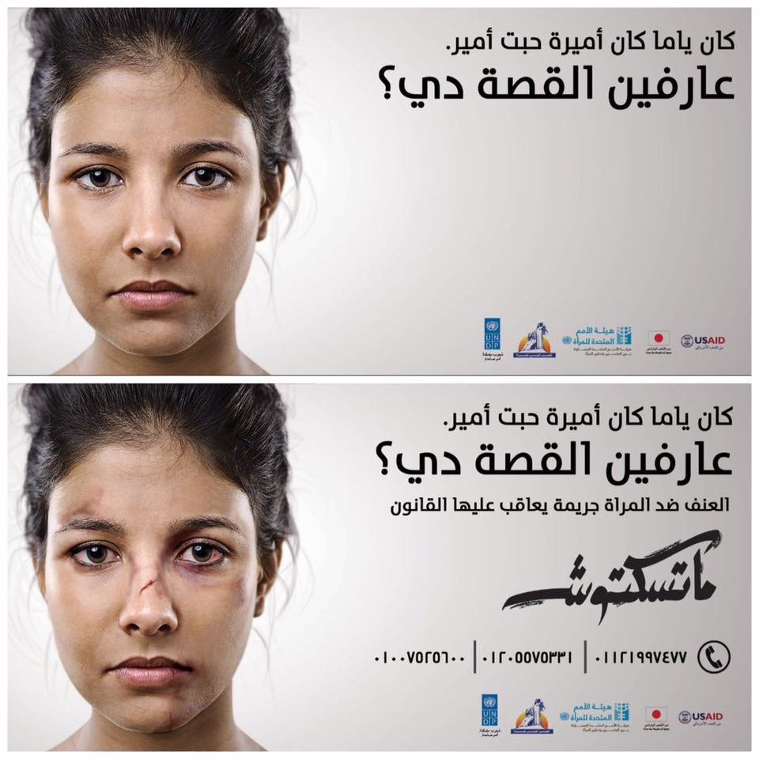
Pillar I – VAW Prevention
2
  Utilization and Development of Communication Technologies
The “Mateskotoush” national media campaign billboard, which displays a woman with a clear face during daylight, changes at night when the billboard lights up, showing signs of battering on the woman’s face. In addition, the NCW helpline numbers, and a line highlighting that VAW is punishable by law in Egypt appear.
  The campaign encouraged citizens to speak up and use the NCW helpline to report and request legal and psychological help; reaching thousands of likes on social media, with an estimated viewership of 1.7 million for TV and radio ads.
There was a 25% increase in incoming phone calls to the NCW Ombudsmen Office hotlines after
the campaign advertised them.

Slide 10
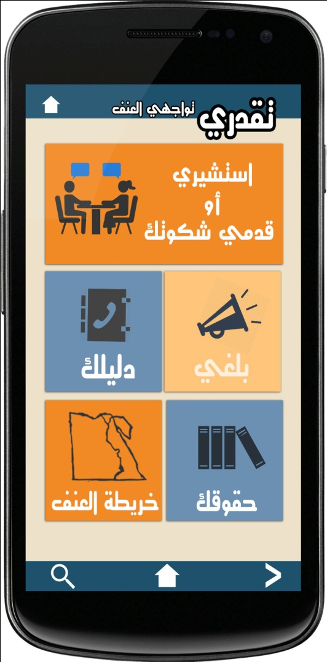
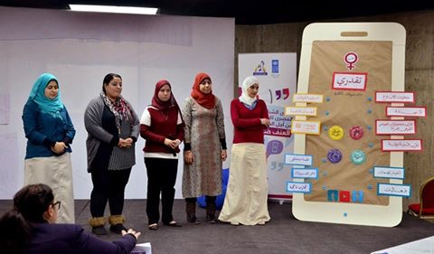
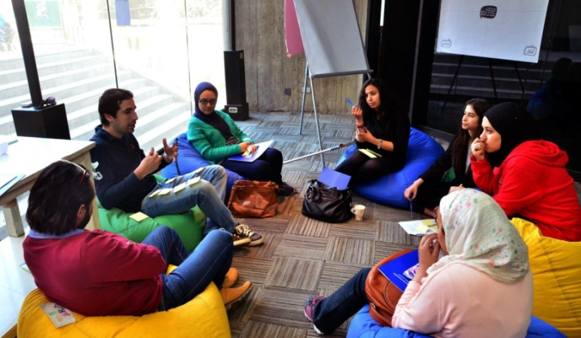
Pillar I – VAW Prevention
2
  Utilization and Development of Communication Technologies
Photos taken during one of the Youth Innovation Camps conducted in 2015, whereby participants suggested the development of a mobile application to facilitate the combatting of VAW through the simplifying VAW reporting procedures. The application is now being developed at the NCW in cooperation with the UNDP.

Slide 11
Pillar I – VAW Prevention
3
  Strengthening Laws and Regulations
      Main Streams
      Examples
      I. The modification of the penal code to strengthen the criminalization of "Sexual Harassment".
Minister of Interior’s Decree No. 2180 for 2014 on the establishment of VAW units in police stations in all Security Directorates.
Articles in the Women in Prison Law
Article No. 19 & 20 which regulates the provision of special medical treatment for women prisoners.
Article No. 30 which stipulates that women prisoners have the right to custody of their children until they reach the age of 4 years instead of 2 years
  II. The preparation of a new legislation addressing VAW&G

Slide 12
Pillar 2 – Protection from VAW
1
  Promoting the Implementation of Law Provisions through Coordination with Concerned Authorities
2
  Creating a Suitable Environment for Reporting via the Efforts of the Ministry of Interior.

Slide 13
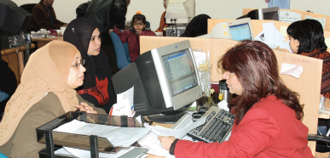
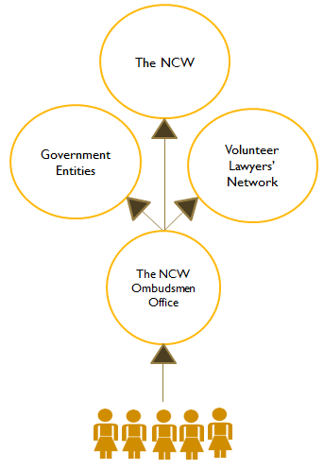
Pillar 2 – Protection from VAW
1
  Promoting the Implementation of Law Provisions through the Development of Coordination Mechanisms
The Ombudsman Office, established in 2001, serves as a conduit between the National Council for Women (NCW) and Egyptian women who face discrimination or are subject to any practices contradicting the principles of equality and equal opportunities provided for by the 2014 Constitution.
The Ombudsmen Office consists of a team of lawyers and social workers who respond to women’s inquires, consultations and legal needs through its hotline, online portal and 27 branches covering the Republic. They coordinate with government entities and a volunteer lawyer network to accelerate the legal process. In addition they identify women’s needs, document and classify these on their database, produce studies and reports to decision makers, and propose legal amendments.

Slide 14

Pillar 2 – Protection from VAW
1
  Promoting the Implementation of Law Provisions through the Development of Coordination Mechanisms
  The establishment of a new sector for “Women & Child’s Rights” and a specialized unit to combat VAW&G at The Ministry of Justice.
  The customization of special chambers in Egyptian courts for VAW cases
  Carrying out training programs targeting men and women judges from different governorates on VAW.
I
II
III

Slide 15
Pillar 2 – Protection from VAW
2
  Creating a Suitable Environment for Reporting via the Efforts of the Ministry of Interior.
  The establishment of a special unit for "Combating VAW&G“ under the Human Rights Sector of the Ministry of Interior.
  Allocating a hotline to receive complaints on VAW and other human rights matters, whereby direct contact is provided with female police officers.
  Providing policemen/women and civil servants with extensive training courses on human rights matters.
  Upgrading public surveillance equipment to trace perpetrators of sexual harassment.
  Increasing security patrols in all cities.
I
II
III
IV
V

Slide 16


Pillar 3 – Interventions to Combat VAW
  The Provision of Services for Battered Women & Girls:
  Availability of NCW Ombudsman Offices all over Egypt’s 27 governorates; an official channel through which women report and get free legal and psychological counseling from.
  Appointing new female police officers in police stations to provide a secure psychological environment for women during case reporting and interrogation.
  The issuing of a Medical Guidebook and Manual on Dealing with Battered Women & Girls and training of hundreds of physicians, forensic doctors and nurses at hospitals by the Ministry of Health.

Slide 17


Pillar 3 – Interventions to Combat VAW
  The Provision of Services for Battered Women & Girls:
  The establishment of shelters to provide psychological and legal assistance to victims of VAW by the Ministry of Social Solidarity.
  Supporting civil society organizations and providing on site legal services for women in three impoverished communities in Greater Cairo (Ezbet el Haggana, Mansheyet Nasser and Imbaba) reaching hundreds of women and community members, under the Safe Cities Global Program.

Slide 18




Pillar 3 – Interventions to Combat VAW
  More about the Safe Cities Global Program:
8
Supporting20,000
Community
Service
Organizations
755
  Legal Consultations Complaints collected
  from women
Reaching 20,000
  working on VAW with organizational development & capacity building, which enabled them to expand their service scope and geographical reach.
200
  &
  out of 30,000 inhabitants of intervention sites which were identified in the baseline scoping study done at the inception of the program.
Law suits filed
Collecting
Training 22 Employees
of
women shelters
of the Ministry of
Social Solidarity
throughout 8
governorates.
33
680
9
  VAW and legal rights awareness sessions
  for
  signatures from women in intervention areas to empower them and present their needs to authorities (300 signatures for requesting the establishment of a police station in the area & 380 signatures for requesting a law amendment that guarantees housekeepers formal labor rights.
3325
  Engaging youth, women and the community in recreational activities and theatre performances covering VAW messages.
  Women

Slide 19

Pillar 4 – Prosecution
I
  Conducting set monthly field visits to different state entities housing women and girls such as the prisons to monitor and assess their situation and increase the efficiency of the government in combatting VAW.
II
  Benefiting from international best practices and experiences in the field of prosecution and the provision of protection and care to victims of violence.
III
The Prosecutor General’s Office - in collaboration with several stakeholders - is establishing a national database system in the different prosecution offices that will allow for monitoring and reporting on VAW cases at all levels of the judicial procedure. In addition, the office is collaborating with UNODC and has approved a training manual for prosecutors. A training program including the training of trainers is about to start followed by a training of trainers program.

Slide 20
Pillar 4 – Prosecution
I
  Conducting set monthly field visits to different state entities housing women and girls such as the prisons to monitor and assess their situation and increase the efficiency of the government in combatting VAW.
II
  Benefiting from international best practices and experiences in the field of prosecution and the provision of protection and care to victims of violence.
III
The Prosecutor General’s Office - in collaboration with several stakeholders - is establishing a national database system in the different prosecution offices that will allow for monitoring and reporting on VAW cases at all levels of the judicial procedure. In addition, the office is collaborating with UNODC and has approved a training manual for prosecutors. A training program including the training of trainers is about to start followed by a training of trainers program.

Slide 21
Thank You for Your Attention.
For more information, please visit our website or contact us via email.
The National Council for Women, Egypt www.ncwegypt.com ncw@ncwegypt.com

