Slide 1
Current Issues of Violence against Women and Girls in Japan:
Situation, legal frameworks, government measures and civil society activities on this issue

Slide 2
This presentation introduces
1.Current Situation of Violence against women in Japan
There are many forms of violence against women and girls in Japan. Violence includes stalking, domestic violence, rape, sexual harassment, maternity harassment, forced prostitution, trafficking, and pornography pornography.
2. Japan’s international contribution for eliminating and preventing violence against women and girls (increased under Prime Minister Abe’s administration).
Notes:
Introduces two issues. The first issue focuses on stalking, domestic violence,rape and maternity harassment as the first nationalsurvey onmaternity harassment was conducted in 2015

Slide 3
1. Stalking
The Stalker Regulation Law - 1st specific law to prevent and stop violence against women (2000).
90% of victims of stalking were women.
There were strong petitions from civil society, including from friends and relatives of the stalking victim to parliament and government for enactment of a law to control stalking.

Slide 4
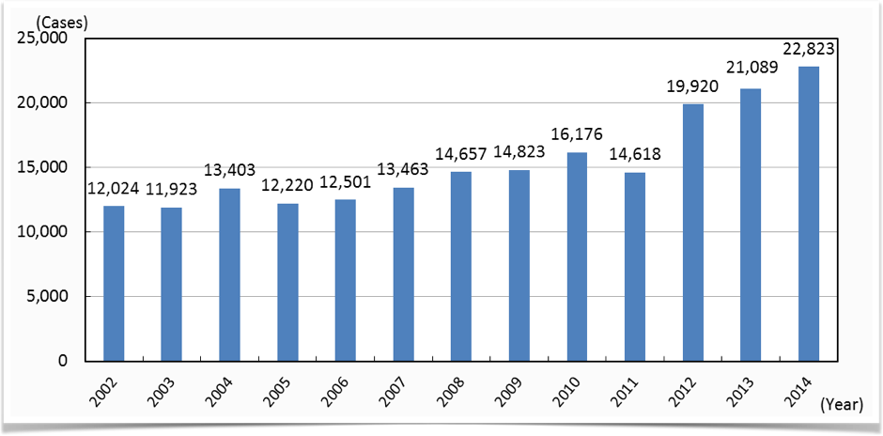
Stalker-related Incidents reported to police offices
Notes:
Staler related incidents has increased year by year

Slide 5
1. Stalking
In 2014, Police offices received 7,649 requests for special support or protection. .
Police provides support such as the issuance of warnings and restraining orders.
Police could arrest stalkers in order to prevent the escalation of harm (Anti-Stalking Act)

Slide 6
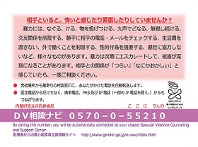
2. Domestic Violence
Legal framework and situation in Japan
International comparison in the incidences of domestic violence

Slide 7
2. Domestic Violence
2-a Legal Framework and Situation
Bureau of Gender Equality, Cabinet Office has conducted a national survey on violence between men and women, every 3 years since 1999.
Results indicated that around 1 out of 3 persons were victims of various violence from partners (men and women).The violence includes either or combination of physical, sexual, verbal and psychological violence.

Slide 8
2. Domestic Violence
2-a Legal Framework and Situation
The Act on the Prevention of Spousal Violence and the Protection of Victims of Japan was enacted in 2001 according to the outcome document UN Special Session of Beijing +5 article 69)
Act was an achievement of female parliamentarians, shelter for VAW survivors and activists. (revised in 2004,2007 and 2013)
The result of the first survey indicated that 1 out of 20 persons experienced a threat to life by their partners.

Slide 9
2. Domestic Violence
2-a Legal Framework and Situation
The national offices working for VAW policies
Bureau of Gender Equality, Cabinet Office
Ministry of Justice
Police Agency
Ministry of Social Welfare
Health and Labor
Ministry of Education ....
Local governments also established similar coordination systems and formulated specific plans of action

Slide 10
2. Domestic Violence
2-a Legal Framework and Situation
Experience of the physical Violence

Slide 11
2. Domestic Violence
2-a Legal Framework and Situation
Frequency of sexual Violence

Slide 12
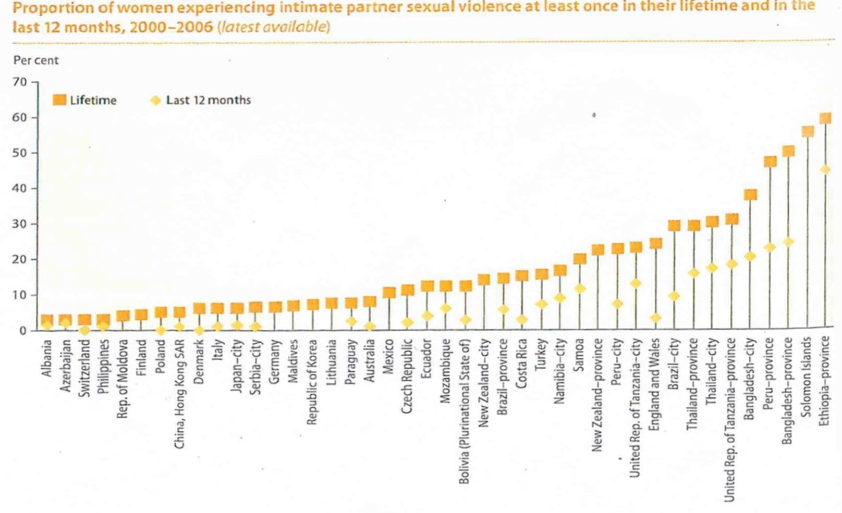
2. Domestic Violence
2-b International Comparison
Source: World Women 2010 p.132
Notes:
World women 2010 data was taken from WHO study

Slide 13
2. Domestic Violence
2-b International Comparison
Occurrence of violence by intimate partners in the city of Yokohama is lower than other countries and cities.
But the difference could be accounted for by a difference in the wording of the questions and the size of the survey samples.

Slide 14
2. Domestic Violence
2-c Public and civil society assistance and support
Whom/where victims/survivors of VAW consulted
 |  | 2014 | 2011 | 2008 | 2005 | 2002 | 1999
Consulted (female victims/survivors) |  | 50.3 | 62.3 | 64.8 | 59.3 | 49.7 | 54.7
Consulted(male victims/survivors) |  | 16.6 | 31.4 | 47.1 | 17.1 | 22.1 | 30.6
 | Family members | 23.4 | 24.5 | 23.8 | 23.4 | 25.5 | 31.8
 | Friends | 21.5 | 23.7 | 21.7 | 22.3 | 25.3 | 31.8
 | Police officers | 1.5 | 5.4 | 1.8 | 2.6 | 2.2 | 1.5
 | Private experts(lawyers, councilors) | 1.5 | 1.6 | 1.4 | 1.9 | 0.4 | 1.1
 | Public counseling centers, women's centers | 0.9 | 2.4 | 1.4 | 1.1 | 0.8 | 0.4
 | Medical experts | 0.7 | 3.1 | 2.9 | 2.6 | 1.1 | 2.2
 | other public officer | 0.6 | 1.2 | - | 0.4 | 0.2 | 1.1
 | Human rights protection officers | 0.4 | 0.4 | 0.4 | 0.7 | 0.2 | 1.5
 | School councilors | 0.4 | - | 0.4 | - | - | -
 | Others | 1.1 | 0.4 | 1.1 | 1.5 | 1.3 | 3.3
Source: Results of Survey of Bureau of Gender Equality, Cabinet Office on Violence among couples from 1999 to 2014

Slide 15
2. Domestic Violence; Public and civil society assistance and support
Government established Spousal Violence Counseling and Support Centers
Civil society established Private shelters
Notes:
Government established support centers have strict roles. Few centers accept non-Japanese women. Officers of government for the centers are changed often. Private shelters accommodate foreign women. Some shelters started for battered foreign wives of Japanese husbands and/or trafficked women from other countries. Private shelters officers become experienced and know the victims/ survivors better than the public officers.

Slide 16
2. Domestic Violence
2-c Public and civil society assistance and support
The number of Spousal violence counseling centers

Slide 17
2. Domestic Violence
2-c Public and civil society assistance and support
108
105
102
93
81
77
55
35
14
1

Slide 18
2. Domestic Violence
2-c Public and civil society assistance and support
Number of Organisations Running Shelters

Slide 19
2. Domestic Violence
Number of consultations which public Spousal Violence Counseling and Support Centerss for women received.
Although the number has increased year by year, only 1-2% of victims/survivors consulted public Spousal Violence Counseling and Support Centers.

Slide 20
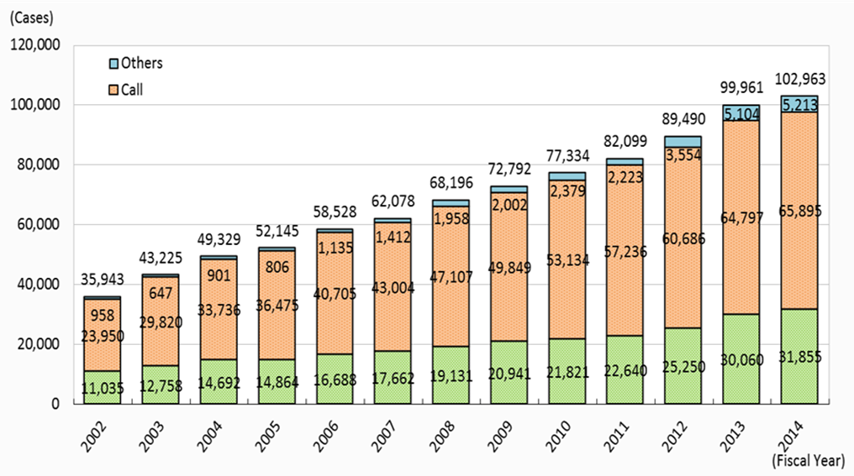
2. Domestic Violence
.

Slide 21
2. Domestic Violence
2-c Public and civil society assistance and support
Under article 10 of the Act on the Prevention of Spousal Violence and the Protection of Victims, victims/survivors can make a petition to the court to issue max. 6 month protective orders.
Perpetrators cannot approach the victim’s residence during the period.

Slide 22
2. Domestic Violence
2-c Public and civil society assistance and support

Slide 23
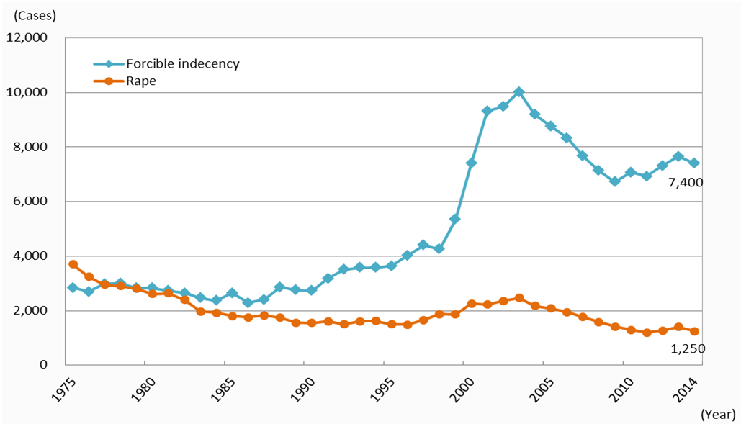
3. Rape
Cases of rape and forcible indecency
reported to the police

Slide 24
3. Rape
Only 42.7% of rape victims/survivors who consulted the rape crisis center reported the incident to the police. Another center;the ratio of reporting incidents to the police was 44.9%.
77.6% of perpetrators of rape were friends/acquaintances, including victim’s father(10%).
​27 one-stop centers for the victims/survivors of sex crimes, including 2 privates. The government targets to establish one-stop centers at every 47 prefectures by 2020.

Slide 25
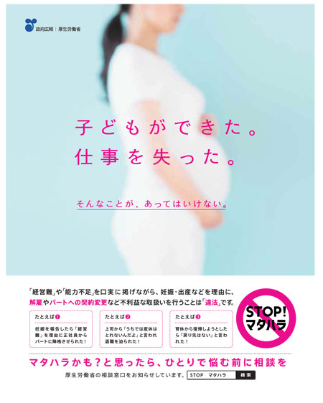
4. Maternity Harassments
1/3 non-regular female workers have been laid off due to their pregnancy.
According to 1st online survey on maternity harassment (2014)

Slide 26
4. Maternity Harassments
National survey in 2015 conducted by the Ministry of Health, Labor and Welfare. Respondents; 9654 women
21.4% of workers both regular and non regular who got pregnant, delivered baby, raise child, have received detrimental treatment due to their pregnancy, child delivery and child rearing.

Slide 27
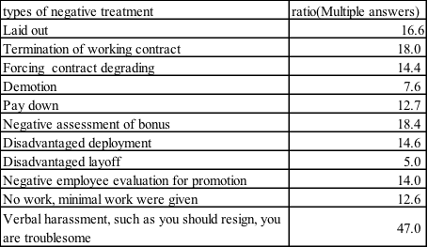
4. Maternity Harassments
Details of discrimination against non-regular workers

Slide 28
Japan’s International Contribution on Eradication and Prevention of Violence against Women

Slide 29
Japan’s International Contribution
Contribution to UN Women
Contribution to the Office of the SRSG on Sexual Violence in Conflict
Contribution to the Trust Fund for Victims of the International Criminal Court
Support PKO’s efforts to prevent and respond to Conflict Related Sexual Violence (CRSV) and Sexual Exploitation and Abuse (SEA) and the protection of women
International Cooperation to support women in developing countries 2011 to 2014 was more than 7 billion US Dollars including JICA ‘s Technical Cooperation project on TIP since 2005, in Thailand, Myanmar and Vietnam

Slide 30
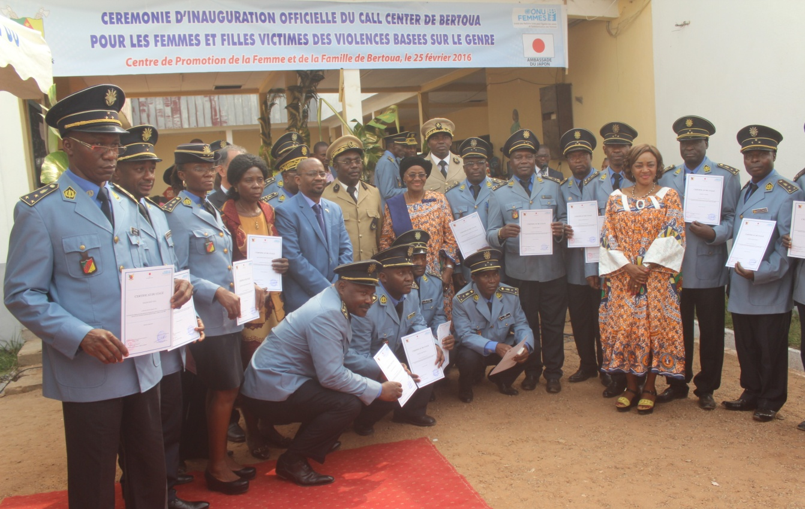
Japan’s International Contribution
PROJECTS UN Women Cameroon 2015
Provision of life-saving integrated GBV services and protection for women and girl refugees in Adamaoua and East Regions of Cameroon (US$ 1000.000)
Photo: UN Women Cameroon

Slide 31
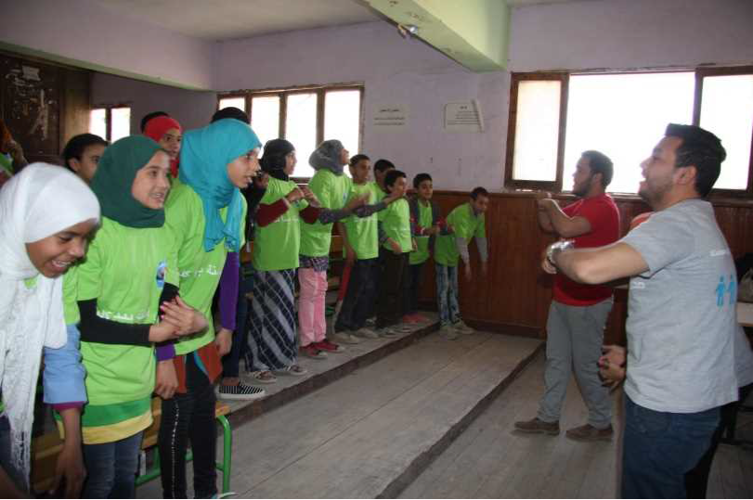
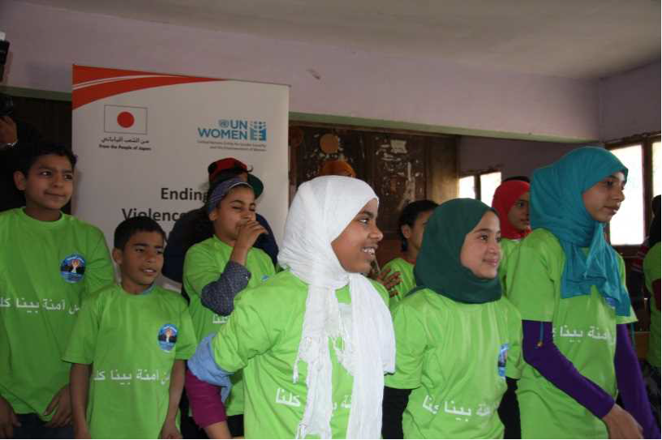
Japan’s International Contribution
PROJECTS UN Women Egypt 2014
Ending Violence against Women: Towards Integrated Approach (US$ 999,665)
Students and volunteers practicing performance to learn self-defense

Slide 32
Thank you for your interest in this presentation
Please refer to the hand out for the details of the presentation

