Slide 1


Institutionalization of the gender perspective in public policies in the Dominican Republic
Minister Janet Camilo
Ministry of Women
Mr. Yván L. Rodríguez B.
Viceminister of Planning
Ministry of Economy, Planning and Development

Slide 2
Results of the Implementation of the Millenium Development Goals 2000-2015

Slide 3

Achievements
Reduction of undernutrition and poverty and improving income distribution
Gender parity in primary education (with positive discrimination gaps at secondary and higher levels)
Control of the incidence of measles and increased coverage in childhood vaccination
Substantial decline in deaths from HIV / AIDS
Increased forest area and reduction of emissions that deplete the ozone layer
Achieved the goal of access to drinking water
Decreased the proportion of people living in poor neighborhoods
Access to ICTs
The country goes forward in improving its presence in the world economy

Slide 4
Targets on track
to be achieved
  Reduction of general poverty and extreme poverty
  Improve the proportion of students who begin primary education and graduate (terminal efficiency)
  Reduction of maternal mortality
  Close the gap on target child mortality
  Reduction of incidences of communicable diseases and vectors: dengue, malaria and others

Slide 5
Achievements on Information
and Dissemination
National System of Indicators Portal
The National Office of Statistics (ONE) presented the National System of Indicators Portal that allows the transparent monitoring of progress of the MDGs by all interested institutions and population in general.
The National System of Indicators can be consulted at: http://ODM.gob.do
This platform was created with the support of the United Nations’ Development Programme (UNDP) and the cooperation of the United Mexican States, which were presented with an award from the Ministry of Economy.
This platform is currently being restructured to begin follow-up of the Sustainable Development Goals (SDG)

Slide 6
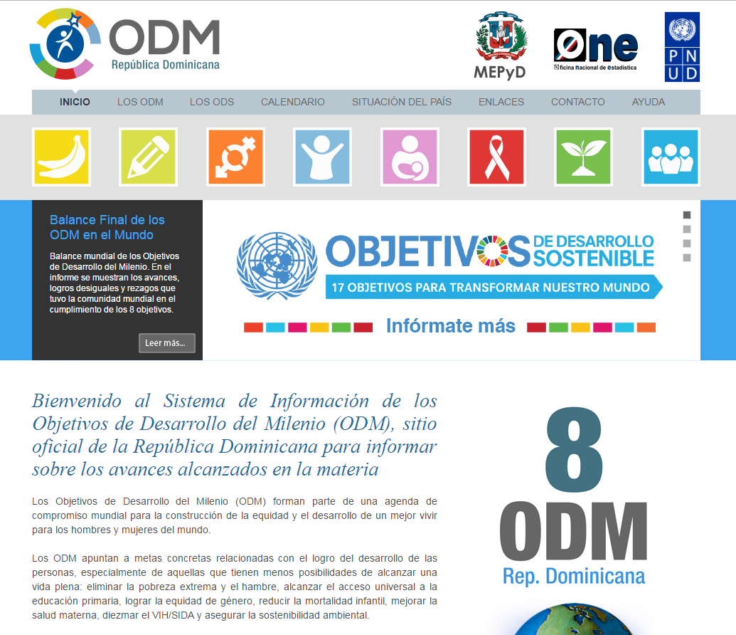
PORTAL ODM-ODS

Slide 7
National Development Strategy 2030
(END)

Slide 8
END Elaboration Process
International and national reference frameworks:
Plans, Institutions and Sectors Diagnoses (PLANEG)
Report of the International Commission for the Strategic Development of the Dominican Republic
The Millennium Development Goals, CEDAW, Beijing Platform for Action, other Human Rights instruments
Economic Commission for Latin America and the Caribbean (ECLAC), the World Bank, the Inter-American Development Bank (IDB), and the Korean Development Institute
Two studies: the Harvard Report: Building a better future for the Dominican Republic, done by the Harvard University Center for International Development and the Dominican Republic 2010-2020

Slide 9
END Mainstreaming policies
The design and management of public policies should incorporate :
Gender Approach
Environmental Sustainability
Territorial Cohesion Dimension
Participation of society in the formulation, execution, audit and evaluation of public policies
The use of information and communication technologies as instruments to improve public management

Slide 10
Country Vision and END Development Axes
Country Vision 2030
The Dominican Republic is a prosperous country where people live with dignity, security and peace, with equal opportunities within a framework of participatory democracy, responsible citizenship and competitive insertion in the global economy, that also takes advantage of its resources to develop in an innovative and sustainable way .
Axis 1
A cohesive society with equal opportunities and low levels of poverty
A state with efficient and transparent institutions at the service of a responsible and participative citizenship, that guarantees security and promotes development and peaceful coexistence
Axis 2
Axis 3
An articulated, innovative and environmentally sustainable economy with a productive structure that generates high and sustained growth with decent employment that achieves competitive insertion into the global economy
Sustainable management of the environment and adequate adaptation to climate change
Axis 4

Slide 11
Adoption of the Sustainable Development Goals (SDG)
and the National Agenda

Slide 12

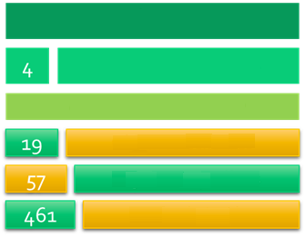
Favorable Context for the Implementation of the SDG
A social and democratic state of law
COUNTRY VISION
Development Axes
A society with equal rights and opportunities
6 Mainstream Policies
General Goals
A sustainable, inclusive and competitive economy
Specific Goals
A society with environmentally sustainable production and consumption that adapts to climate change
Action Lines

Slide 13
Agenda END vs. SDG
END – 2030 - DR
Agenda 2030 for SDG
1 Vision
4 Development axes or pilars
19 General goals
57 Specific goals
461 Action lines
90 Indicators system for follow-up
6 Mainstreaming axes
1 Vision
3 SD axes or pilars
17 Goals
169 Targets
A 231 indicadors system for follow-up

Slide 14
Alignment END-ODS
 | SDG | Strategic Axis END 2030
People | SDG 1; SDG 2 SDG 3; SDG 4 SDG 5 | Strategic Axes 2 Strategic Axes 3
Planet | SDG 6; SDG 12; SDG 13; SDG 14; SDG 15 | Strategic Axes 2 Strategic Axes 4
Prosperity | SDG 7; SDG 8; SDG 9; SDG 10; SDG 11 | Strategic Axes 2 Strategic Axes 3
Peace | SDG 16 | Strategic Axes 1

Slide 15
Achievements and Challenges for the Implementation of the SDG
Achievements
Creation of the National Commission for Sustainable Development (CNDS), through Decrees No. 23-16 and 26-17
The CNDS is composed by ministers or ministries delegates, other relevant bodies of the public sector, civil society, development agencies in the territory and the private sector
Challenges:
Move towards new goals
Align and execute the 2030 National Development Strategy with the SDG
Operation of the National Commission for Sustainable Development

Slide 16
Process of mainstreaming
gender equality in the END

Slide 17
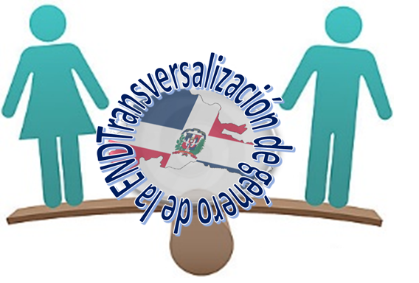
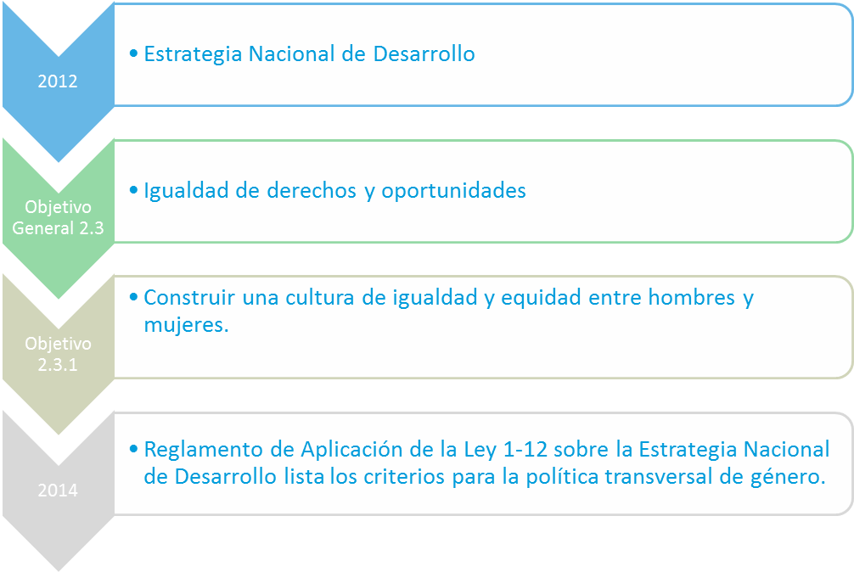
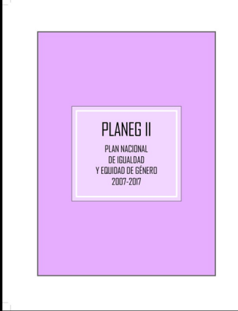
Background and Normative Framework
2010
2007
2012
Principle of equality incorporated in the Dominican Constitution. (Art.39)
National Development Strategy
PLANEG II (2007-2017)
Equal rights and opportunities
Build a culture of equality and equity between men and women
Regulation for implementing law 1-12 on the National Development Strategy lists the criteria for gender mainstreaming policy

Slide 18
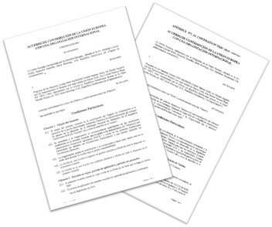
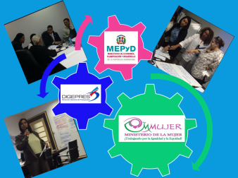
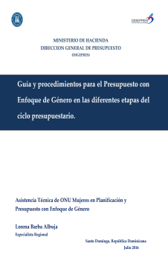
Actions up to date
2014
2015
2016
Technical Assistance requested by the Ministry of Women to the UN-Women National Office
Interinstitutional coordination between MMUJER, MEPYD and the Budget Directorate-General
Financing Support from the European Union
Interinstitutional agreement between the Ministry of Women (MMUJER) and the Ministry of Economy, Planning and Development (MEPYD)
Elaboration of criteria for the selection of pilot institutions
Creation of programme-related categories in 8 governmental pilot institutions
Interinstitutional Agreement to begin the Gender Transversal Pilot Programme in the implementation of END2030 (12 institutions involved: 4 governing institutions + 8 pilot institutions)
Production of methodological tools (planning and budgeting)
The process included: Training and capacity building + production of conceptual documents + technical assistance by the UN-Women National Office + Financial Support from the European Union and South South-Cooperation

Slide 19
Process Progress
Interinstitutional Coordination: Establishment of permanent coordination between MMUJER, Ministry of Finance, Ministry of Public Administration; and Ministry of Economy, Planning and Development
Intra-institutional coordination: Creation of technical teams within the governing institutions and pilots (planning and financial directorate, gender equality and development offices)
Financing for equality: Allocation of resources for gender equality and the empowerment of women through specific program categories and sub-functions beginning in 2015

Slide 20
Advances
Mainstreaming of Guidelines for the elaboration of the National Budget : Elaboration of a guiding document and procedures for budgets with guidelines for the elaboration of the 2017 national budget with a gender focus
Capacity building on gender equality of the technical personnel that take part in the governing institutions of the process and the pilot institutions

Slide 21
Next Steps
To design a strategy that will allow the process of gender mainstreaming in the implementation of the National Development Strategy to achieve continuity of the implementation of the SDG, aimed at the High Political Level Inter-Institutional Commission for Sustainable Development that was created by Presidential Decree 26 -17, and of which the Ministry of Women is a member.
Ensure that the setting of goals and targets, the development of means of implementation and that the use of indicators to monitor the progress of the SDG include women's rights and consultation mechanisms of women's organizations and social oversight.

Slide 22
Lessons Learned
The mainstreaming of gender perspective as a technical and political process
Political will is decisive for the progress of the process
It requires the developing of technical capacities to design the strategies that target overcoming the barriers of the process
Inter-institutional coordination is imperative
Take into account the specificities of the stake-holders in the process
Importance of South-South cooperation

Slide 23


