Slide 1
Review Theme:
Achievements and Challenges In The Implementation Of The MDGs for Women and Girls in Indonesia
Subandi Sardjoko
Deputy Minister for Human, Society and Cultural Development
Ministry of National Development Planning/BAPPENAS
Presented at the 61st Session of CSW, dated 15 - 16 March 2017,
United Nations Headquarters

Slide 2
OUTLINE
I. Review of MDGs implementation in Indonesia in relation to gender
2. Achievement of MDG indicators
3. Example of good practices
4. Key gaps and challenges
II. Efforts to implement the SDGs in Indonesia in relation to gender
MDG indicators related to gender equality in Indonesia

Slide 3




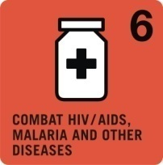
I. MDGs
Achievement
Poor population
Nutrition & Calorie Intake
Maternal Mortality Rate
Indonesia's achievement in 2015:
18 Unfinished
49 Achieved
1. Coverage of forest area
2. CO2 Emissions
3. Rural Water
4. Proper Sanitation
5. Urban Slum Areas
Ratio of exports and imports to GDP
Internet access
HIV and AIDS Prevalence

Slide 4

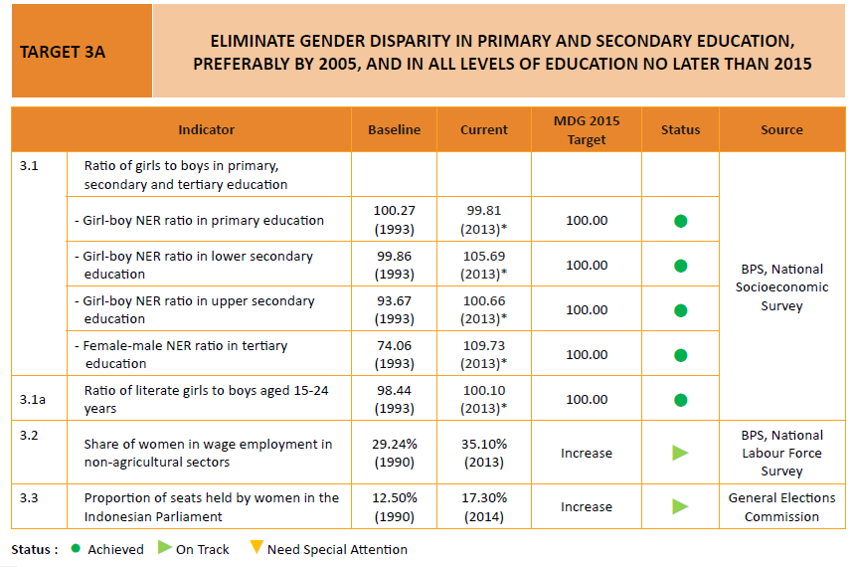
1. MDG Indicators related to
Gender Equality in Indonesia

Slide 5
Trend in Ratio of NER for Girls to Boys by Educational Level, 2000-2015
2. Achievement of MDGs Indicators
Source: BPS, National Socioeconomic Survey, various years.

Slide 6
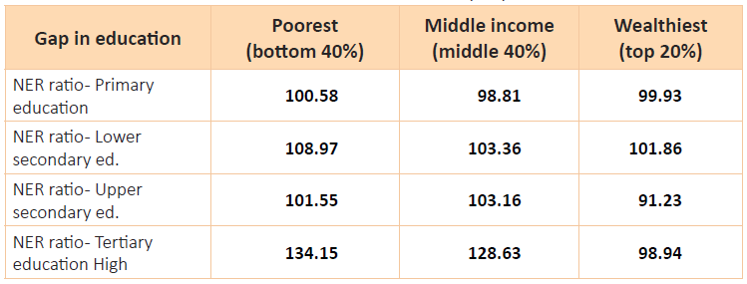
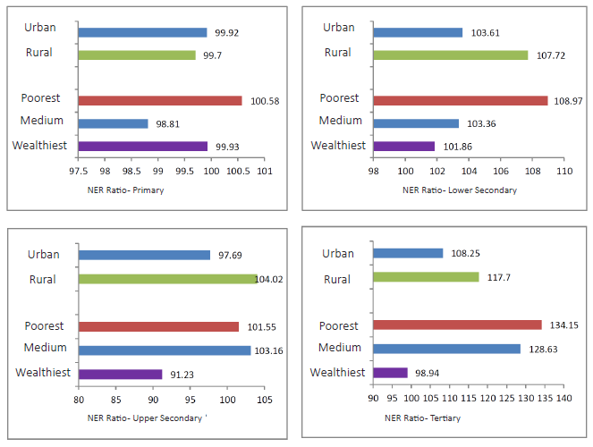
NER by Level of Schooling, Urban/Rural Area and Economic Status
NER Ratio at Each Level of Education, by Expenditure Levels, 2013
Source: BPS, National Socioeconomic Survey

Slide 7
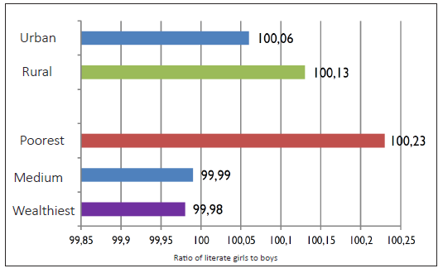
Ratio of Literate Girls to Boys by Urban/Rural Area and Economic Status, 2013
Source: BPS, National Socioeconomic Survey 2013

Slide 8
Share of Women in Wage Employment in
Non-agricultural Sectors, 2000-2015
Source: BPS, Sakernas

Slide 9
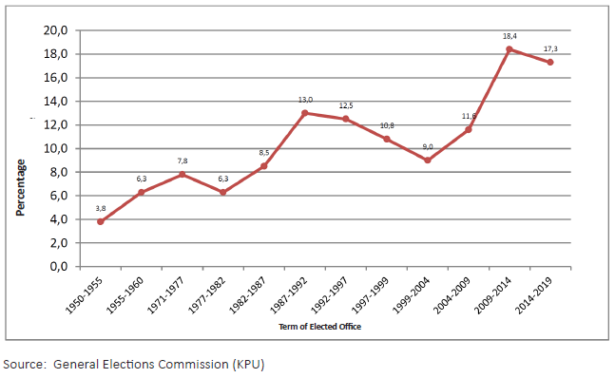
Trend in Women’s Representation in The Indonesian Parliament by Term of Elected Office, Term of Elected Office 1950-2014

Slide 10
3. Example of Good Practices (1)
2007: Gender Responsive Planning and Budgeting (PPRG) initiative, based on evaluation result of implementing PUG in gov. agencies and regional gov.
RPJMN 2010-2014: PUG be integrated into planning and budgeting system, PPRG, Gender Responsive Budgeting (ARG), Gender Budget Statement (GBS), Regulation of Minister of Finance (PMK), Regulation of Minister of Home Affairs (Permendagri), Circular Letter (SEB)
A. Good Practice at Policy Level
2016: Evaluation of Stranas PPRG to develop the existing strategy
RPJMN 2015-2019: Gender Mainstreaming in national priorities
UU No. 6/2014 on Rurals that mandating the involvement of women in decision making
2012: National Strategy to Accelerate Gender Mainstreaming through PPRG (Stranas PPRG)
RPJMN 2004-2009: PUG is stated as one of the principles to be maintreamed in all development policies/programs/activities; and RPJPN 2005-2025.
GBHN 1999-2004: Gender equity and equality as one of the objectives of national development
Propenas 2000-2004: 19 development programs were considered gender responsive
Inpres No.9 / 2000: The instruction for all ministries and government bodies as well as the regional heads to implement Gender Mainstreaming (PUG)
1998: Gender Analysisi Pathway (GAP) drafted

Slide 11
3. Example of Good Practices (2)
Successful collaborations with stakeholders
Government
The Ministry of Education has implemented reforms to realize gender equality and equity:
  Capacity building for policy makers and planners to be able to formulate gender sensitive policies, action plans and programs, such as gender responsive school education (PSBG), both at the national and sub-national levels
  Increased partnerships with women's studies centres and other research institutions
  Increased partnerships with NGOs / women's organizations in developing tailored training for women, including in gender-based family education (PKBG)
  Strengthening data systems to be able to collect credible gender statistics
Non State Actors
Training of women in IT facilities and development of micro businesses by the Sragen Library Office and the Independent Women's Center (WMC) resulted in an increase in sales turnover of 30-40% per year through improved online marketing.

Slide 12
3. Example of Good Practices (3)
  C. Leveraging investment in women through ODA: Australia’s MAMPU Program
  Australia-Indonesia Partnership for Women’s Empowerment and Gender Equality (‘MAMPU Program’), 2012-2020
  Supports networks of CSOs (national and local) to work on solutions to increase poor women’s access to basic Government services and programs in five thematic areas
  DESBUMI – Village-based approach to provide women migrant workers better access to services. Initially trialed by Australia in 18 villages, in October 2016, the Ministry for Labour rolled out the initiative to 100 villages across Indonesia.
  ‘Integrated Criminal Justice System’ (SPPT-PT) – Is an integrated, cross-sectoral system for better handling cases of Violence Against Women between counsellors, police, health services, and court system. Initially trialed in Semarang, Central Java in 2015, the successful case management system was adopted by the provincial government of Central Java to scale up the approach across Central Java.

Slide 13
4. Key Gaps and Challenges
The challenges faced in achieving Goal 3 of the MDGs were:
The mindset of decision makers still interprets gender as a woman’s agenda and product of the West, and therefore they persist in gender bias and discrimination,
Gender mainstreaming has not yet been implemented at a conceptual level and in context with international, national and thematic issues in all facets of development that represent the competence of the central and regional governments under the complex system of decentralization and regional autonomy,
Protection of women and children remains inadequate, particularly in the face of globalization issues related to human trafficking and violence in increasingly complex and diverse forms, including physical and psychological violence, exploitation, neglect and so on,
Political education for women candidates face many impediments.

Slide 14
II. Efforts to implement the SDGs in Indonesia Related to Gender
Gender Mainstreaming in SDG Goals and Targets in Indonesian Policy
2. Metadata of SDGs Indicators in Indonesia (Provision of data-disaggregated by Sex , as well as economic status, region, and age group)
3. Challenges of the SDGs Implementation

Slide 15
1. Gender Mainstreaming in SDGs in Indonesian policy
Strategy:
Ensure the policy directions and indicators reflect SDG gender markers
Ensure indicators are disaggregated by sex
The Status of January 2017:
Based on the mapping of indicators SDGs, there are more or less 120 indicators relevant to gender.
Out of the 120 indicators, 17 are directly related to gender under Goal-5: achieve gender equality and empower all women

Slide 16
Gender-related Indicators in SDGs
Related to:
Poverty
Food and Nutrition
Health
Family Planning
Education
Violence against women and children
Clean water and sanitation
Energy
Reduce inequality
Employment
Industry
Urban and Settlement
Climate change
Marine
Peaceful, justice, and strong institutional
Partnership

Slide 17
2. Metadata of SDGs Indicators in Indonesia
(Provision of data-disaggregated by sex)
Strengthen the evidence base by improving data collection, report on gender indicators and develop new methodologies for measuring progress and performance
Goal 5: Gender Equity Metadata SDGs Indicators :
  Concept and Definition
  Methodology
  Benefit
  Data Resources
  Disaggregation
  Frequency for Data Collection

Slide 18
Metadata of SDGs Indicators in Indonesia (1)
Related to CSW58 - Five Key Areas of Focus of the Agreed Conclusions
TARGET | INDICATOR |  | REMARKS
ENABLING ENVIRONMENT
5.1 End all forms of discrimination against all women and girls everywhere | 5.1.1* | Whether or not legal frameworks are in place to promote, enforce and monitor equality and non-discrimination on the basis of sex. | National indicator that matches the global indicator
FULL REALIZATION OF WOMEN’S AND GIRLS’ HUMAN RIGHTS
5.2 Eliminate all forms of violence against all women and girls in the public and private spheres, including trafficking and sexual and other types of exploitation | 5.2.1* | Proportion of ever-partnered women and girls aged 15 years and older subjected to physical, sexual or psychological violence by a current or former intimate partner in the previous 12 months, by form of violence and by age. | National indicator that matches the global indicator
 | 5.2.2* | Proportion of women and girls aged 15 years and older subjected to sexual violence by persons other than an intimate partner in the previous 12 months, by age and place of occurrence | National indicator that matches the global indicator

Slide 19
Metadata of SDGs Indicators in Indonesia (2)
Related to CSW58 - Five Key Areas of Focus of the Agreed Conclusions
TARGET | INDICATOR |  | REMARKS
FULL REALIZATION OF WOMEN’S AND GIRLS’ HUMAN RIGHTS
5.3 Eliminate all harmful practices, such as child, early and forced marriage and female genital mutilation | 5.3.1* | Proportion of women aged 20-24 years who were married or in a union before age 15 and before age 1 | National indicator that matches the global indicator
 | 5.3.2 | Proportion of girls and women aged 15-49 years who have undergone female genital mutilation/cutting, by age | Missing Indicator
5.4 Recognize and value unpaid care and domestic work through the provision of public services, infrastructure and social protection policies and the promotion of shared responsibility within the household and the family as nationally appropriate | 5.4.1 | Percentage of time spent on unpaid domestic and care work, by sex, age and location | Missing Indicator

Slide 20
Metadata of SDGs Indicators in Indonesia (3)
Related to CSW58 - Five Key Areas of Focus of the Agreed Conclusions
TARGET | INDICATOR |  | REMARKS
WOMEN’S PARTICIPATION
5.5 Ensure women’s full and effective participation and equal opportunities for leadership at all levels of decision-making in political, economic and public life | 5.5.1* | Proportion of seats held by women in national parliaments and local governments | National indicator that matches the global indicator
 | 5.5.2* | Proportion of women in managerial positions | National indicator that matches the global indicator
FULL REALIZATION OF WOMEN’S AND GIRLS’ HUMAN RIGHTS
5.6 Ensure universal access to sexual and reproductive health and reproductive rights as agreed in accordance with the Programme of Action of the International Conference on Population and Development and the Beijing Platform for Action and the outcome documents of their review conferences | 5.6.1* | Proportion of women aged 15-49 years who make their own informed decisions regarding sexual relations, contraceptive use and reproductive health care | National indicator that matches the global indicator
 | 5.6.2* | Number of countries with laws and regulations that guarantee women aged 15-49 access to sexual and reproductive health care, information and education | National indicator that matches the global indicator

Slide 21
Metadata of SDGs Indicators in Indonesia (4)
Related to CSW58 - Five Key Areas of Focus of the Agreed Conclusions
TARGET | INDICATOR |  | REMARKS
FULL REALIZATION OF WOMEN’S AND GIRLS’ HUMAN RIGHTS
5.a Undertake reforms to give women equal rights to economic resources, as well as access to ownership and control over land and other forms of property, financial services, inheritance and natural resources, in accordance with national laws | 5.a.1 | (a) Proportion of total agricultural population with ownership or secure rights over agricultural land, by sex; and (b) share of women among owners or rightsbearers of agricultural land, type of tenure | Missing Indicator
 | 5.a.2 | Proportion of countries where the legal framework (including customary law) guarantees women’s equal rights to land ownership and/or control | Missing Indicator
5.b Enhance the use of enabling technology, in particular information and communications technology, to promote the empowerment of women | 5.b.1* | Proportion of individuals who own a mobile telephone, by sex | National indicator that matches the global indicator
MAXIMIZING INVESTMENTS
5.c Adopt and strengthen sound policies and enforceable legislation for the promotion of gender equality and the empowerment of all women and girls at all levels | 5.c.1 | Proportion of countries with systems to track and make public allocations for gender equality and women’s empowerment | Missing Indicator

Slide 22
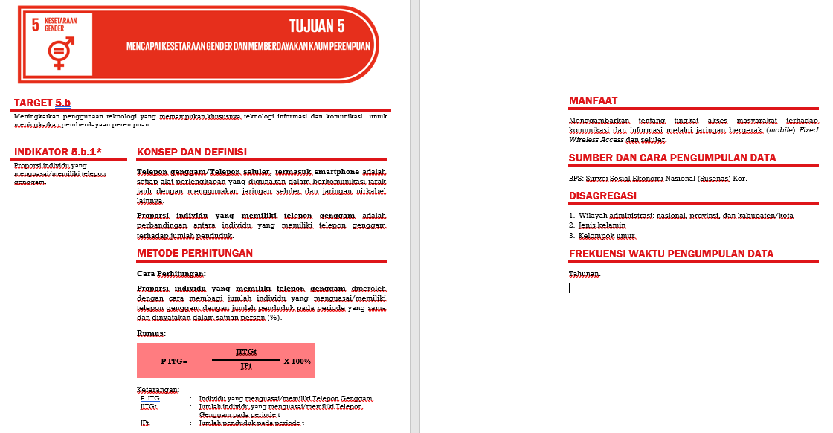
Example: Metadata of SDGs indicators Document Goal 5: Gender Equity

Slide 23
3. Challenges in Implementing the SDGs
Implementation of the inclusive and ‘no one left behind’ principle.
Provincial coordination in developing the SDGs Subnational Action Plan involving all Districts/Municipalities and all stakeholders in the provincial and district/municipality level.
Development of the SDGs database and its disaggregation (by sex, urban-rural, age group, income level, disability, migration status, etc).
Coordination for monitoring and evaluation involving all stakeholders, at the national, provincial and district/municipality level.
Coordination in developing the SDGs Achievement Annual Report, at the national, provincial, and district/municipality level, involving all stakeholders.
Dissemination of SDG information to the public to ensure they understand the benefits and are part of the SDGs implementation in their everyday life.

Slide 24

Thank You

