Slide 1
Challenges and achievements in the implementation of the
Millennium Development Goals for Women and Girls

Slide 2
Introduction
Mexico’s commitment to achieve GEWE is carried out through the implementation of the National Development Plan 2013 -2018, which aims to mainstreaming gender at every governmental level, in order to close the gaps and eradicate barriers that cause exclusion, inequality and discrimination.
Gender mainstreaming and other international commitments find the adequate means to strengthen in the international agenda and multilateralism.

Slide 3
Achievements
Extreme poverty - Addressed as a structural problem with differentiated impacts in women and men, was reduced in more than half, from 9.3% in 1989 to 3.7 in 2014.
Since 2008 Mexico implemented a multidimensional measurement of poverty, that calculates this phenomena forma a human rights approach which allows to address it in a more effective way.
Education - In 2014, it was reached universal coverage of primary schooling, which reduced disparity among girls and boys. Alphabetization rate of women between 15 and 24 years reached also 98%, its equivalent to men.
Political participation - The proportion of seats occupied by women increased. At the Lower House: from 12.4% representation in 1988 to 42.4% in 2015, and at the Senate from 15.6% to 34% during the same reference years.

Slide 4
achievements
Health access - Since 1992, prevalence of HIV/AIDS in our country declined, and in 2013 was only 0.23% of the population of 15-49 years, below the goal of maximum of 0.6% of that population group.
Others transmitted diseases as the malaria also decreased significantly leaving as one of the main challenges the eradication of the tuberculosis.
Sustainability of the environment - In this respect, we have reduced by a 0.27%, ozone-depleting substances; increased access to services of drinking water in a 90.9% and sanitation in a 87.7%; and decreased the prevalence of urban shanty from 35.7% to 17.1%.
All of the above are fundamental factors in the empowerment and development of women and girls.
Mexico reached the goals provided in 37 of 51 indicators, equivalent to 72.5% compliance.

Slide 5
Challenges: from MDGs to SDGs
Multidimensional poverty and women’s participation
 | 2010 | 2015
School lag | 21.9 | 18.7
Access to health services | 27.1 | 14.7
Access to social security | 58.8 | 55.0
Quality housing | 14.9 | 11.8
Access to basic housing services | 22.6 | 20.2
Access to food | 24.6 | 21.5
Stagnation in income increse:
43%
Labor Market
Goals to 2018:
48%
Labor Market
-20%
Wage
inequality
Fuente: INMUJERES con metodología del CONEVAL con base en el MCS-ENIGH 2010, y MCS 2015.

Slide 6
Challenges: from MDGs to SDGs
2. Maternal mortality
MDG: 22.2
Result: 34.6
From 2014 to 2015 it was reduced 11%
Universal care of obstetric emergencies
Prevention and care of indirect causes of maternal death
Promotion of post-obstetric contraception
Strategy of prevention and intercultural care
Maternal Mortality Observatory in Mexico

Slide 7
National Capacities
MDGs follow up allowed our country to develop national capacities and to create new mechanisms of coordination and evaluation, as well as pioneer systems of monitoring, nowadays considered as international models.
Besides the impact of the MDGs they also triggered institutional changes, among others:
Statistical Systems;
Monitoring and Institutionalization;
New Information Systems; and
Evaluation and Accountability

Slide 8
Best practices on Gender Statistics
17 years of fostering national and International Gender statistics.
Specialized Committee of Information with Gender Perspective of the national System of Geographic and Statistical information.
VaW Survey as National Interest Information.

Slide 9
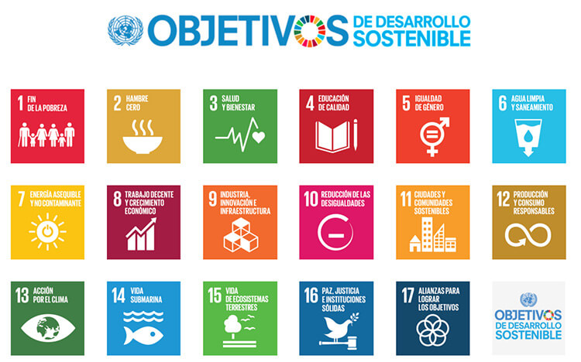
Mexico face to Agenda 2030

Slide 10
Mexico face to Agenda 2030
Participation throughout the SDGs negotiation in line with our international commitments on human rights, reflected in its main components.
One of its priorities was GEWE as crosscutting axis for development.
Agreed position with Latin-American countries face to 58CSW, not as a only goal along all A2030 contents.

Slide 11
Trabajo institucional alineado a las directrices
Centralized coordination
High level coordination
Transparency
Local and all level participation
Budget allocation
International cooperation
NGO participation

Slide 12
Lessons learnt from Civil Society
Results
Advances (partial and heterogenous)
Human rights approach
Gender mainstreaming
Structural changes & sustainability
Collateral damage of interventions

Slide 13
Lessons learnt from Civil Society
CS challenges
a. Follow up MDGs
Process interruptions
Resources mobilization
b. Reassessment to SDGs
Human rights commitments articulation
Long term address to promote sustainable changes
c. CS and Government articulation
Cooperation relations
Civil society contributions: technical approach, visibilization of specific needs and creation of indicators
Monitoring and entailment

