Slide 1

Challenges and achievements in the implementation of the Millennium Development Goals for Women and Girls
CSW61 , New York
16 March 2017
Notes:
CHALLENGES AND ACHIEVEMENTS IN THE IMPLEMENTATION OF THE MILLENNIUM DEVELOPMENT GOALS FOR WOMEN AND GIRLS
INTRODUCTION
The Millennium Declaration and eight Millennium Development Goals, which were endorsed by the leaders of 189 UN Member States in 2000, played a decisive role in the formulation and implementation of the long and medium-term national development strategy, economic development planning and policy mechanisms along with monitoring and evaluation systems in Mongolia. The Parliament of Mongolia adopted the MDGs as development benchmarks in 2005 and then as the framework for the MDG-based Comprehensive National Development Strategy for 2008-2021.

Slide 2
MDGs and Mongolia
The State Great Khural of Mongolia endorsed the national MDGs in 2005 and approved MDGs-based National Comprehensive Development Strategy in 2008.
  Played a key and decisive role in formulating and developing long and medium term national development policies and strategies.
  Had an impact on strengthening policy implementation, monitoring and evaluation systems.
Mongolia formulated and implemented its unique 9th goal on “Strengthening human rights and fostering democratic governance” devoted to democratic governance and human rights.
  Progress has been made in in promoting transparency, encourage citizen’s participation.
Progress has been made in promoting gender equality and increasing women’s participation in political decision-making.
Notes:
In 2005 the State Great Khural (Parliament) of Mongolia endorsed the Mongolian MDGs by adding the 9th MDG on “Strengthening Human Rights and Fostering Democratic Governance”. The MDGs targets and indicators were revised and approved by the State Great Khural Decree No 13 in 2008. As a result of efforts to adopt the 9th MDG “Strengthening Human Rights and Fostering Democratic Governance”, Mongolia made notable progress in the areas of transparency of governance and citizens’ participation, and reduction of corruption. According to Transparency International, Mongolia had been ranked on corruption index as 120th in 2011, whereas in 2014 was 80th out of 174 countries.
Since the adoption of the MDGs, Mongolia has made significant progress in their implementation. Mongolia has successfully met the target of MDGs to reduce child mortality, improve maternal health, combat HIV and AIDS and to develop new ICT and build an information society. In addition, significant headway was made in promoting the gender equality and increasing women’s participation in decision-making.

Slide 3
MDGs and Mongolia
Mongolia fully achieved some MDGs:
  Goal 4: Reduce child mortality,
  Goal 5: Improve maternal health,
  Target 21: Development of new information communication technology and build an information society.
Some Millennium Development Goals are not fully achieved: For example:
  Goal 1, Target 3: Reduce youth unemployment,
  Goal 5, Target 12: Reduce the incidence rate of tuberculosis,
  Goal 7, Target 14: Protect the environment, reduce air pollution in urban areas, especially in Ulaanbaatar.
Notes:
Challenged and difficulties faced
Financial and economic crisis,
Weak governance and institutions,
The development policies are not cohesive and consistent

Slide 4
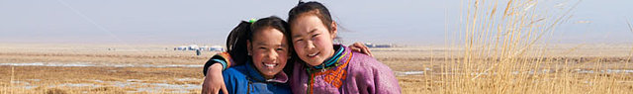


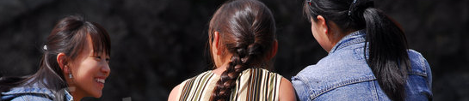
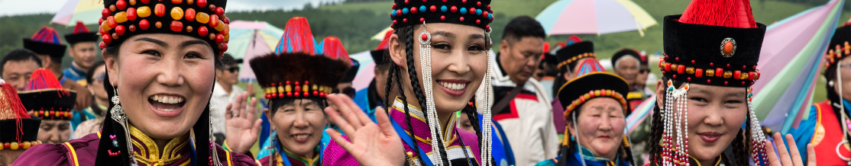
Content
REALIZING WOMEN’S AND GIRLS’ FULL ENJOYMENT OF ALL HUMAN RIGHTS
STRENGTHENING THE ENABLING ENVIRONMENT FOR GENDER EQUALITY AND THE EMPOWERMENT OF WOMAN
MAXIMIZING INVESTMENTS IN GENDER EQUALITY AND THE EMPOWERMENT OF WOMEN
STRENGTHENING THE EVIDENCE-BASE FOR GENDER EQUALITY AND THE EMPOWERMENT OF WOMEN
ENSURING WOMEN’S PARTICIPATION AND LEADERSHIP AT ALL LEVELS AND STRENGTHENING ACCOUNTABILITY

Slide 5
REALIZING WOMEN’S AND GIRLS’ FULL ENJOYMENTOF ALL HUMAN RIGHTS
  Enabling policy framework for gender equality and women’s rights
Implementation of women’s economic rights
Implementation of girls’ right to
free education
Notes:
REALIZING WOMEN’S AND GIRLS’ FULL ENJOYMENT OF ALL HUMAN RIGHTS

Slide 6
  ENABLING POLICY FRAMEWORK FOR GENDER EQUALITY AND WOMEN’S RIGHTS
2006
2012
2016
National programme on preventing women and children from trafficking in persons and sexual exploitation
Law to Combat Trafficking in Persons
National programme to combat trafficking in persons 2016-2021 formulated in compliance with internationally accepted 4 paradigms
Notes:
Enabling policy framework for gender equality and women’s rights
Mongolia fully supports international human rights standards and is a signatory to all major international instruments pertaining to women’s rights and gender equality, including the Universal Declaration of Human Rights, the International Covenant on Economic, Social and Cultural Rights, the International Covenant on Civil and Political Rights, the Convention on the Political Rights of Women, the Convention on the Elimination of All Forms of Discrimination against Women, the Convention on the Rights of the Child, the United Nations Convention against Transnational Organized Crime and its Protocol to Prevent, Suppress and Punish Trafficking in Persons, Especially Women and Children, and the International Labour Organization (ILO) conventions on equal remuneration and discrimination in respect of employment and occupation, among others. In line with the international standards, the Constitution of Mongolia and relevant laws prohibit discrimination on the basis of sex and uphold gender equality.
The Government of Mongolia has been taking a host of measures to combat trafficking in person by adopting laws and legislation and ratifying international conventions in order to properly regulate relations to ensure victims right, prevention, investigation, identification of the causal factor of the crime. For example, “National Program on Preventing Women and Children from Trafficking in Person and Sexual Exploitation" was approved by the Government of Mongolia in 2006.
In addition, the Government of Mongolia adopted the Law to Combat Trafficking in Persons in 2012. National Program on Combating Trafficking in Persons for the period of 2016-2021 has been formulated in compliance with internationally accepted 4 paradigms-prevention, protection, investigation, and cooperation.

Slide 7
  ENABLING POLICY FRAMEWORK FOR GENDER EQUALITY AND WOMEN’S RIGHTS
2004
2007
2016
Law to combat domestic violence
National program to combat domestic violence
Revision of the Law to Combat Domestic Violence has been drafted and adopted by Parliament of Mongolia on 28 December 2016 and enforced from February 2017
Notes:
In 2005, in adopting the MDGs, the Parliament set concrete gender-related targets in employment, education, political participation and health. The MDGs based Comprehensive National Development Strategy adopted in 2008 reaffirms these commitments and includes additional strategic objectives to adopt a separate law on gender equality, integrate gender equality content at all levels of education and ensure women’s equal rights to property.
The Government of Mongolia adopted Law on Combating Domestic Violence in 2004, National program on Combating Domestic Violence in 2007 respectively. Several measures have been taken to ensure implementation of the legislations, including establishing shelter house for victims, providing counseling services.
Due to lack of enforcement, inappropriate and incomplete specification in the law, there was a need to improve the Law on Domestic Violence. Revision of the Law on Combating Domestic Violence has been adopted by the Parliament of Mongolia on 28th, December 2016 and has entered into force from 1 February 2017.

Slide 8
  IMPLEMENTATION OF WOMEN’S ECONOMIC RIGHTS: EMPLOYMENT
2011
In the the revised Labor Law, the below issues are indicated:
Law on Promotion of Gender Equality
Workplace discrimination;
Prevention from sexual harassment at workplace;
Equal wage for everyone regardless of gender;
Responsibility and penalty mechanism to the employer, who did not create non discriminative work environment
REFORM
Notes:
Implementation of women’s economic rights: Employment
Mongolia supports the ILO decent work agenda and seeks to implement a balanced and integrated programme approach to achieving full and productive employment and decent work for all, providing men and women with equal opportunities to obtain work in conditions of freedoms, equity, security and human dignity. Mongolia is committed to improve the legal framework for ensuring the labour rights of all, in line with the ILO Declaration on Fundamental Principles and Rights at Work and ILO Conventions No.29 and No.105 on forced labour; Conventions No.100 and No.111 on equality of opportunity and treatment; Conventions No.89 and No.98 on the rights to organize; and Conventions No.138 and No.182 on child labour, to all of which Mongolia is a party to.
In the draft revised Labor Law, ensuring gender equality in labor relation is clearly stipulated in accordance with the Law on Gender Equality. In addition, issues related to workplace discrimination, prevention from sexual harassment at workplace, equal remunerationfor everyone regardless of gender and responsibility and penalty mechanism for an employer, who did not create non-discriminative work environment, are specifically indicated.

Slide 9
  IMPLEMENTATION OF WOMEN’S ECONOMIC RIGHTS: EMPLOYMENT
EVIDENCE
Labour Research Institute studies (2013 & 2015):
Average monthly wage of workers has been on the increase every year; however, male empoyees are paid about 15% higher than female employees
There is a gender pay gap at both management and staff level positions.
Notes:
According to a research, conducted by the National Statistics Office, male workers are paid about 15,9% higher compared to female workers. A wage and compensation structure study, conducted by the Labour Research Institute in 2013 and 2015, has shownthat there is a gender gap in both management and staff level positions. Therefore, the new draft Labour Code reflects the sanctity of 1951 Equal Remuneration Convention number 100.

Slide 10
MEASURES TAKEN TO ENSURE EMPLOYMENT RIGHT
Updated and new programmes recently implemented by the Ministry of Labour and Social Protection:
Preparation for labour,
Employment skills programme,
Youth employment promotion,
Start-up business programme,
Employment promotion on herders,
Support to creation of workplaces for persons with disabilities, and
Advisory services of senior specialists and others.
Women occupy 42,7% of jobs created in the result of the above programmes.
Notes:
In order to promote employment, Ministry of Labour and Social Protection is implementing several programs including Employment promotion program, Youth employment and start-up business promotion program, Herder's employment promotion program, Disabled Persons Employment Promotion Program and Senior expert's counselling service program. Women are working in 42.7 percent of permanent workplaces which were created within the framework of the above-mentioned programs. According to the statistics, in Mongolia women employment rate is 50.5, labour force participation rate is 54.3 and unemployment rate is 6.9 percent respectively.

Slide 11
IMPLEMENTATION OF GIRLS’ RIGHT TO FREE EDUCATION
2006
Net enrolment ratio in 2014-2015:
99.1% in primary education
96.1% in middle school (6-9th grades)
Girls’ enrolment ratio 0.8-1% higher than boys’
Gender index in secondary education in 2014-2015:
0.96 % in primary school
0.97 % in middle school
In other words, 96-97 girls are allotted to 100 boys studying in middle and primary schools
In compliance with the Constitution, the LAW OF MONGOLIA ON EDUCATION states that
“Mongolian citizens shall be given equal opportunities of receiving education in their mother tongue, and they shall not be subject to educational discrimination on account of race, creed, age, sex, social status, economics position, employment status, religion or opinion.”
Result:
2009
The Government launched Free Textbook Policy
to provide up to 40% of textbooks for students of middle school and 100% of textbooks for students of primary school.
Notes:
Implementation of girl’s right to free education
In compliance with the Constitution, the Law on Education(2006) states that “Mongolian citizens shall be given equal opportunities of receiving education in their mother tongue, and they shall not be subject to educational discrimination on account of race, creed, age, sex, social status, economic position, employment status, religion or opinion.” This clause ensures human rights to be in line with democratic norms and serves as a guarantee for citizens to exercise broad rights in gaining education. The Law on Education also requires every citizen of Mongolia to have basic education.
Moreover, the Law on Education provides that “education shall be free, accessible, and variable adjusted to individual and development specialties, type of education and needs of learner” as well as “parents and custodians have a duty not to prohibit children under 16 from receiving basic education.” These clauses serve as a guarantee for all boys and girls to exercise their right to receive basic education. These legislations and articles ensure that the state affords equal opportunity for all citizens in their education process and guarantee citizens’ Constitutional right to education, and show that children have every right to gain free basic education.
The Government of Mongolia has issued several policy documents to provide accessible educational service for entire population and to ensure the right to have high quality education.
The normative cost for a student, who is involved in the equivalency program of non-formal education, correspondence course, evening course and full-time course of the high schools is funded by the state budget. The Government of Mongolia has been providing full payment for elementary class students' school book will be fully and 40% of payment for middle class students' schoolbooks since 2009. As a result, net percentage of enrollment rate in primary education was 99.1 per cent and in middle class /6-9 class/ 96.1 per cent in the academic year of 2014-2015. According to gender index statistics of academic year of 2014-2015, girls school enrollment is 0.96 percent higher in elementary school, 0.97 percent higher in middle school compared to boys.
Furthermore, courses on sexual and reproductive health, gender equality, gender justice gender rights and roles were included in core curriculum of the primary education.

Slide 12
STRENGTHENING THE ENABLING ENVIRONMENT FOR GENDER EQUALITY AND THE EMPOWERMENT OF WOMAN
Law to Combat Domestic Violence - 2016
Law on Parliamentary Elections - 2015
Lack of political will
Law on Combating Trafficking in Persons- 2012
To ensure gender equality, empower women and protect human rights of women and girls
National Committee on Gender Equality headed by the Prime Minister of Mongolia
Stereotypes in the society
Law on Promotion of Gender Equality - 2011
Lack of financial, technology and human resources
National Program on Combating Domestic Violence - 2007
Law on Combating Domestic Violence - 2004
National Program on Gender Equality - 2002
Notes:
To ensure gender equality and protect human rights, especially, women's’ and girls’ rights, the Government of Mongolia adopted National program for gender equality in 2002, Law on Combating Domestic Violence in 2004, National Program on Combating Domestic Violence in 2007, Law on Ensuring Gender Equality in 2011, Law on Combating Human Trafficking in 2012, Revised Law on Parliamentary Elections in 2015, and amended Law on Combating Domestic Violence in 2016. These legislations serve as a core legal framework for ensuring gender equality. In 2013, the Government of Mongolia also adopted medium term strategy (2013-2016) for implementing the Law on Gender Equality.
The Parliament approved the “Public Policy of Population Development (2016-2025)” in 2015, the “Sustainable Development Vision of Mongolia 2030” in 2016.

Slide 13

MAXIMIZING INVESTMENTS IN GENDER EQUALITY AND THE EMPOWERMENT OF WOMEN
To increase financial resources and improve gender sensitive budgeting
To protect women’s economic rights and empower them economically
Notes:
According to the National Programme for Ensuring Gender Equality, the Government recognizes the importance of enhancing women’s employment and ensuring their equal rights in employment, promoting women’s social, economic and political empowerment, fostering human development and reducing poverty.
With a view to create more jobs, the Government is taking systematic measures aimed at promoting economic growth, developing medium and small enterprises and employment facilitation. The Economic Growth Support and Poverty Reduction Strategy was developed and implemented with support of the World Bank and the International Monetary Fund. In 2001, following the adoption of the Law on Employment Facilitation, the Government launched the nationwide services of employment facilitation and business incubation for unemployed people.
In 2007, the Law on Small and Medium Enterprises was adopted, and the Small and Medium Enterprise Support Fund was established. The Fund issues loans for small businesses at discounted interest rates and supports efforts to improve management and employee skills.

Slide 14
INCREASING FINANCIAL RESOURCES AND GENDER SENSITIVE BUDGETING
One of the key challenges Mongolia currently faces in mainstreaming gender into national policy and programs is gender-sensitive budgeting
As NCGE established in 2005 has been under-budgeted for many years, there is a pressing need to provide gender programmes with sufficient funding and find new and innovative ways of funding.
Notes:
Although the Government of Mongolia has been developing and implementing a wide range of social and economic programs targeting different groups of women, not every program succeeded or reached desirable outcomes mainly due to lack of financial and human resources. Consequently, one of the key challenges Mongolia currently faces in mainstreaming gender into national policy and programs is gender-sensitive budgeting.
During the last decade, the Government of Mongolia put considerable efforts to create gender-responsive planning and budgeting following examples and best practices of governments of different countries. Under the Law on Promotion of Gender Equality, the Government of Mongolia is mandated to incorporate gender equality promotion activities in the national and sector development policies and programs, introduce gender sensitive budgeting system, approve and implement gender equality programs and special measures and have sufficient financing approved for their implementation.
Furthermore, briefings on gender sensitive planning and budgeting at the Parliamentary Standing Committees on the state budget, education and science, the information, first ever gender auditing of the budget, inclusion of gender sensitive planning and budgeting topic into the university curriculum and first time online course on gender sensitive budgeting for Ministry of Finance officials have become remarkable steps toward the improvement of gender mainstreaming into policy documents and budget planning and overall public awareness and knowledge.

Slide 15
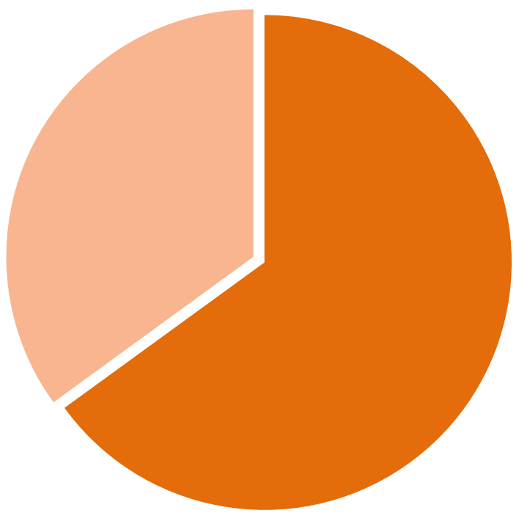
Protection of women’s economic rights and women’s economic empowerment
Poverty,
Domestic violence and other gender-based violence, and
Slows down advancement of women…
under-represented at decision making levels
economically dependent
65% of women
Notes:
As women’s economic rights have not been sufficiently exercised, today, 65 percent of women are under-represented at decision making levels and are economically dependent having limited ownership and opportunities for properties, financial assets, credits and small business/business expansion loans.

Slide 16
Protection of women’s economic rights and women’s economic empowerment
2014
NCGE initiatives:
Subprogram on Women’s Economic Empowerment
Guidebook for future development
In the last decade, the Government of Mongolia has been putting considerable efforts to improve gender mainstreaming into national and sector development policies and programs and to introduce gender-sensitive budgeting system.
The Subprogram aims
to ensure equal economic rights and benefits for women as men including equal opportunity for land tenure, owning immovable and movable properties, financial assets, credits and other economic wealth and resource, and
to ensure equal rights to education and development
Notes:
The main institution mandated to coordinate the gender equality policies at the national level is the National Committee for Gender Equality(NCGE) was established in 2005. The Ministry of Labour and Social Protection has also a department/division in charge of women, children and youth, older persons and family development. However, as the NCGE has been under-budgeted for many years, there is a pressing need to provide gender programmes with sufficient funding and find new and innovative ways of funding as allocating a certain portion of the mining profits to social development issues including gender equality and women’s empowerment.
In 2014, the NCGE drafted a Sub-program dedicated to women’s economic empowerment and a Guidebook for further development was published. The Sub-program aims to ensure equal rights and benefits for women as men including equal opportunity for contributing to and benefitting from the national economy and to provide a wider opportunity for owning land and other immovable and movable properties, financial assets, credits, and other economic wealth and resources and having equal rights to education and development as well.

Slide 17
Protection of women’s economic rights and women’s economic empowerment
Thus, women’s involvement into the economics is important for:
increasing household income,
assisting families to overcome poverty and
increasing women’s overall contribution to the national economy
Although women occupy nearly 50% of the workforce, they are still considered as welfare beneficiaries instead of benefactors and it has negative influences on their advancement and promotion.
Notes:
Although women occupy 50 percent of the workforce, in policy documents, they are still considered as welfare beneficiaries instead of benefactors and it has negative influences on their advancement and promotion. Therefore, women’s economic empowerment is an indispensable factor for increasing household income, assisting families to overcome poverty and increasing women’s overall contribution to the national economy.

Slide 18
STRENGTHENING THE EVIDENCE-BASE FOR GENDER EQUALITY AND THE EMPOWERMENT OF WOMEN
STRENGTHENING THE EVIDENCE-BASE FOR GENDER EQUALITY AND THE EMPOWERMENT OF WOMEN
The Government needs technical and financial support to make long-term and substantial changes in addressing gender-based violence (GBV) issues
Create knowledge about the current situation of GBV and its causes across the country through data collection
Raise public awareness and sensitize decision-makers to the issue of GBV
Improve and expand response and support mechanisms for GBV survivors
Notes:
Although sex-disaggregated data is collected and reported by the National Statistics Office in its yearbook, making use of that data at all levels - from policy planning through service provision - is still not adequate. Gender-based analyses and gender impact assessments thus cannot be properly conducted in any sector, resulting in ignorance of the existing gender gaps and constraints at the policy-making level. This has resulted in gender-blind interventions and an absence of gender-sensitive budgeting.

Slide 19



STRENGTHENING THE EVIDENCE-BASE FOR GENDER EQUALITY AND THE EMPOWERMENT OF WOMEN
National gender institutions are cooperating with NSO to determine country-specific goals, indicators and expected outcomes of the “SDG 5. To achieve gender equality and empower all women and girls”
In 2015, the NCGE and NSO defined major indicators and calculation methods for country specific gender statistics in line with internationally recognized methodology
Multi-year sex-aggregated statistics consisting of 49 indicators for 1900-2014 were issued and made available to the public via Internet.
Notes:
In 2015, in order to improve gender sensitivity of official data and administrative statistics, the NCGE and the State Registration and Statistics Office took measures to define the major indicators and calculation methods for country specific gender statistics in line with internationally recognized methodology. The measures include:
Scope, definition and calculation methods for sex disaggregated data and gender statistics have been developed, and NSO approved a list of 14 groups of indicators with 216 sub-indicators for the nationwide use.
Multi-year sex-aggregated statistics consisting of 49 indicators for 1900-2014 were issued and made available to the public on the Internet.

Slide 20


STRENGTHENING THE EVIDENCE-BASE FOR GENDER EQUALITY AND THE EMPOWERMENT OF WOMEN
In spite of recent improvements in gender-based statistics covering mortality, education and employment, availability of gender sensitive data such as unpaid domestic and care work and violence against women is still limited.
Swiss Agency
for Development
and Cooperation
Government
of Mongolia
United Nation Population Fund
Combating gender-based violence in Mongolia
2016-2020 project
Notes:
Gender institutions are cooperating with NSO to determine national goals, indicators and expected outcomes of the “SDG 5.To achieve gender equality and empower all women and girls” which is one of the 17 goals specified in “Transforming Our World: the 2030 Agenda for Sustainable Development.”
In spite of recent improvements of the gender-based statistics covering mortality, education and employment, availability of gender sensitive datasuch as unpaid domestic and care work and violence against women is still limited.

Slide 21
ENSURING WOMEN’S PARTICIPATION AND LEADERSHIP AT ALL LEVELS AND STRENGTHENING ACCOUNTABILITY
51,7%
of the total population of Mongolia
#13
13 out of 76 MPs are women in the Parliament of 2016-2020
60,7%
of the Mongolian women
have higher education
44%
of all public servants are women.
20%
Established gender quota of 20% for candidates from political parties
2016
Election law revised
Women’s Caucus formed in the Parliament with the aim to promote women rights, gender equality, increase women’s participation and representation in all social sectors, as well as vocal on issues of child protection, family development, protection of the rights of older persons and persons with disabilities.
Notes:
Promoting women’s participation at decision-making level is one of the important priority of the Government of Mongolia. Women have actively used this political space to work through political parties and or non-governmental organizations to exercise their political rights, obtain party nomination or promote nomination of female candidates for national and local elections and appointment of women to high-level government posts.

Slide 22
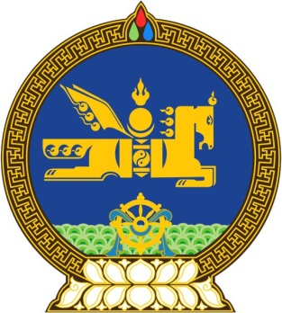
ENSURING WOMEN’S PARTICIPATION AND LEADERSHIPAT ALL LEVELS AND STRENGTHENING ACCOUNTABILITY
In accordance with the Law on Promotion of Gender Equality, all government agencies should submit an annual report on the quota implementation to the NCGE
…quota provisions to ensure gender equality at decision-making levels in state and local government and enterprise organizations. Furthermore, representation of women at all levels of public administration institutions and local government bodies ought to be 15-40 percent.
in 2017
132 government officials are working in the Ministry of Labor and Social Protection
83 or 62% of them are women
Also 63% of total senior officials are women
Article 10 of the Law on Gender Equality

Slide 23
ENSURING WOMEN’S PARTICIPATION AND LEADERSHIPAT ALL LEVELS AND STRENGTHENING ACCOUNTABILITY
Conduct gender auditing
on political party policies and activities
Develop action plans to introduce gender concepts
Eliminate discrimination and implement
Create a legal environment, that provides at least 35 % of the elected MPs are women and elected members in the provinces and at least 40% at the capital city
Establish and implement provision on the quota and establish performance indicators for government positions, nominations and selection processes
To prepare and train women for leadership positions through constant capacity building activities
To set political party rules to implement quotas/reserve minimum 35% of seats for women
IMPLEMENTATION
Notes:
Currently, political parties are undertaking initiatives to amend their rules with a provision about having 20-50% of women in their decision-making bodies

Slide 24
TRANSITION FROM MDGs to SDGs
  Mongolia achieved some of MDGs and targets by 2015.
  The leading factor to this success was effective policy and programme interventions, including the MDGs-based Comprehensive National Development Strategy and Health Care Strategies.

Slide 25


TRANSITION FROM
MDGs to SDGs
Mongolia SDG Vision 2030 contains an aspiring sustainable social development objective to
ensure gender equality,
improve the quality of and access to health care services,
create a healthy, safe living environment for the citizens,
improve public awareness on health education,
provide equal education of high quality to every citizen,
build a national system for lifelong education,
end all forms of poverty, and
increase the share of middle- income classes sustainably and consistently.
MONGOLIA's
2030 Sustainable Development Vision was adopted by the Parliament in 2016
Notes:
Mongolia achieved some of MDGs and targets by 2015.
The leading factor to this success was effective policy and programme interventions, including the MDGs-based Comprehensive National Development Strategy and Health Care Strategies.
By 2030, the Development Vision envisages, inter alia, eradication of poverty in all its forms, sustaining an annual economic growth at least at 6.6%, securing no less than 80% of the total population as middle-or high-income strata through reducing income inequality and ensuring citizen's participation, improved human development through quality educational and health services, ensuring ecological balance and green development while building effective, transparent governance institutions.

Slide 26
TRANSITION FROM
MDGs to SDGs and CONCLUSION
Challenges in meeting the SDGs cannot be underestimated. Building an enduring partnership involving local governments, the national government, the private sector and civil society at home, and development partners, both bilateral and multilateral, is essential for its effective implementation.
Notes:
By 2030, the Development Vision envisages, inter alia, eradication of poverty in all its forms, sustaining an annual economic growth at least at 6.6%, securing no less than 80% of the total population as middle-or high-income strata through reducing income inequality and ensuring citizen's participation, improved human development through quality educational and health services, ensuring ecological balance and green development while building effective, transparent governance institutions.

Slide 27
Thank you!

