Slide 1

Gender Statistics at the UN Statistical Commission
70 years of the United Nations Statistical Commission

Slide 2
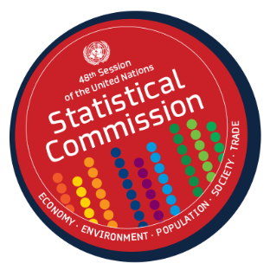
UN Statistical Commission and
Gender Statistics
Key topic of discussion at the Statistical Commission since early 1980s, mid-way into the United Nations Decade for Women: Equality, Development and Peace (1976-1985) and in response to the call for more statistics on the status of women.
International Women’s conferences have been a driving force for the development of gender statistics. They have brought together users of statistics, created a demand for statistics to monitor conferences outcomes, set a political agenda for action to implement agreed outcomes and mobilized resources.

Slide 3

Snapshot of UNSC work on gender statistics
1980 - 1995
The Statistical Commission:
Requested the development of methodologies; the identification of indicators; the compilation of data and the provision of training to measure critical women’s concerns including women’s economic empowerment
Called on UNSD as focal point of work on gender statistics
Agreed on the use of the term “gender statistics” instead of “statistics on women”
Recognized the important contribution of the World’s Women Reports, in particular for the 4th UN World Conference on Women (Beijing, 1995)

Slide 4

During 1995-2005
The Statistical Commission:
Recognized the importance of measuring time use for gender statistics
Requested the UN Statistics Division to develop a draft classification of activities for time use statistics
Endorsed the UNSD methodological guidelines on producing time use statistics

Slide 5
From 2006 to 2017
The Statistical Commission regularly covered gender statistics (yearly since 2011); Requested a comprehensive review of GS programmes at the national and international levels (done by Ghana-NSO 2011) and made the following decisions:
In terms of coordination
  Urged UNSD to strengthen its leadership role in gender statistics (2011)
  Acknowledged the strategic role of the Inter Agency and Expert Group on Gender Statistics (IAEG-GS) to serve as advisory and coordinating mechanism for the global programme on gender statistics (2011)
    Requested IAEG-GS to meet annually (10th meeting was held in 2016); Global Forums on Gender Statistics every other year (6th meeting was held in 2016)

Slide 6
From 2006 to 2017
In terms of methodological developments to measure gender issues, the Statistical Commission:
  Encouraged greater integration of gender statistics into other areas of official statistics, including sustainable development indicators (2013)
  Took note of the Guidelines on integrating gender into official statistics (2013)
  Adopted the Core list of violence against women indicators, identified by the Friends of the Chair on VAW indicators (2009) and accompanying UNSD guidelines (2013)
  Endorsed the International Classification of Activities for Time Use Statistics- ICATUS (2017)
  Agreed to use the Minimum Set of Gender Indicators to guide national and international compilation of gender statistics (2013)
  Welcomed the draft Methodological Guidelines to measure asset ownership and entrepreneurship from a gender perspective (EDGE project – UNSD/UNWomen, 2017)

Slide 7
Outcomes of the Global Gender Statistics Review (Ghana-NSO, 2011))
For the international statistical community, the Statistical Commission:
  emphasized the importance of capacity building on gender statistics
  requested an evaluation of national production and reporting of gender statistics
  noted the importance of trend analysis provided by UNSD World’s Women five-years reports
  reiterated the importance of developing and improving basic sources of gender statistics such as CRVS
  underscored the needs to develop concepts and methods to assess gender difference in poverty and domestic violence and violence against women

Slide 8
Compilation of gender statistics
2030 Agenda for Sustainable Development – Goal 5 and more gender relevant indicators
Challenges for regular (traditional) data producers
  Underreporting, vulnerable groups, confidentiality
Harmonization of statistical standards for comparable data
Exchange of best practices
  on development of innovative tools, non-traditional data sources, data dissemination and communication tools

Slide 9
Dialogue between statistical data producers
Role of potential data producers need to be further defined
  Importance of the NSO in production and dissemination of the gender based statistics
  Strong partnerships with various agencies, development partners, civil society organizations to satisfy data users and data needs
  Gender dimension in each step of statistical production

Slide 10
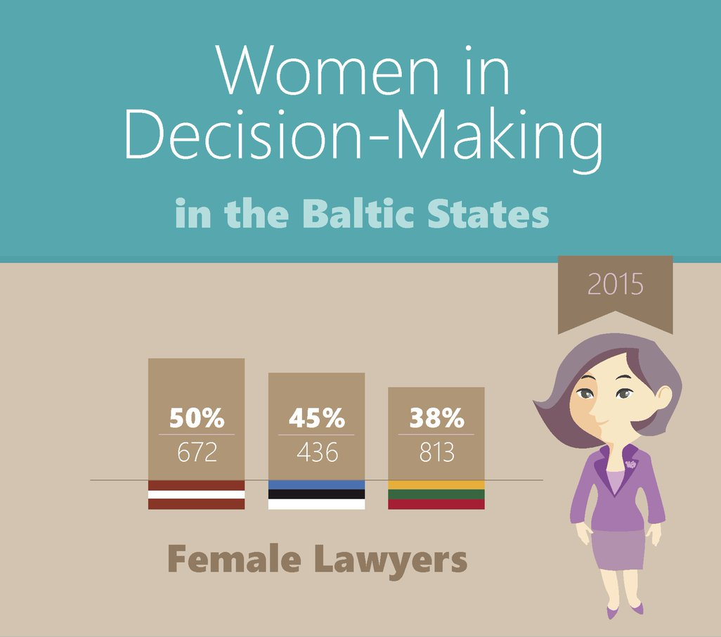
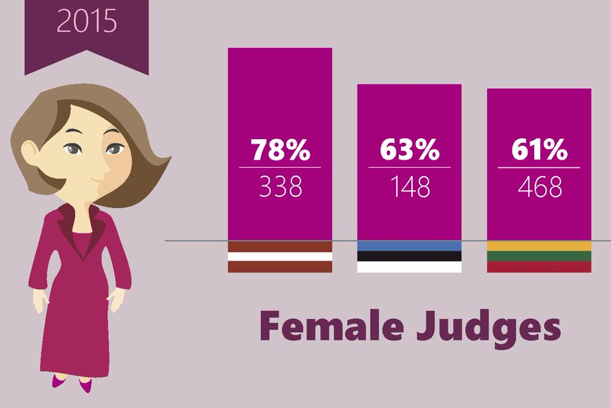
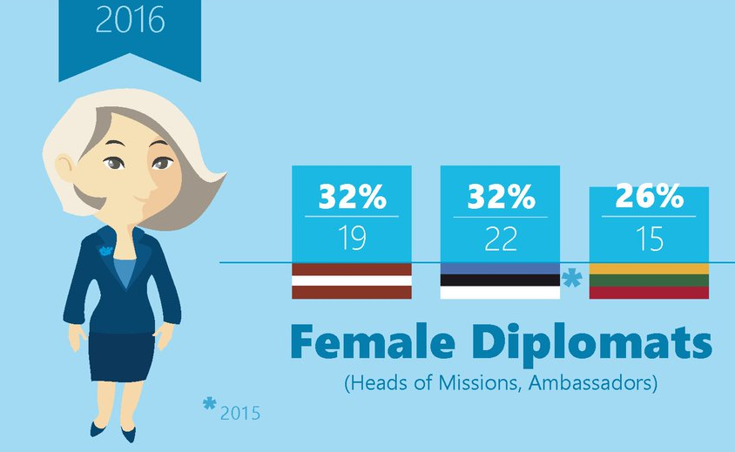
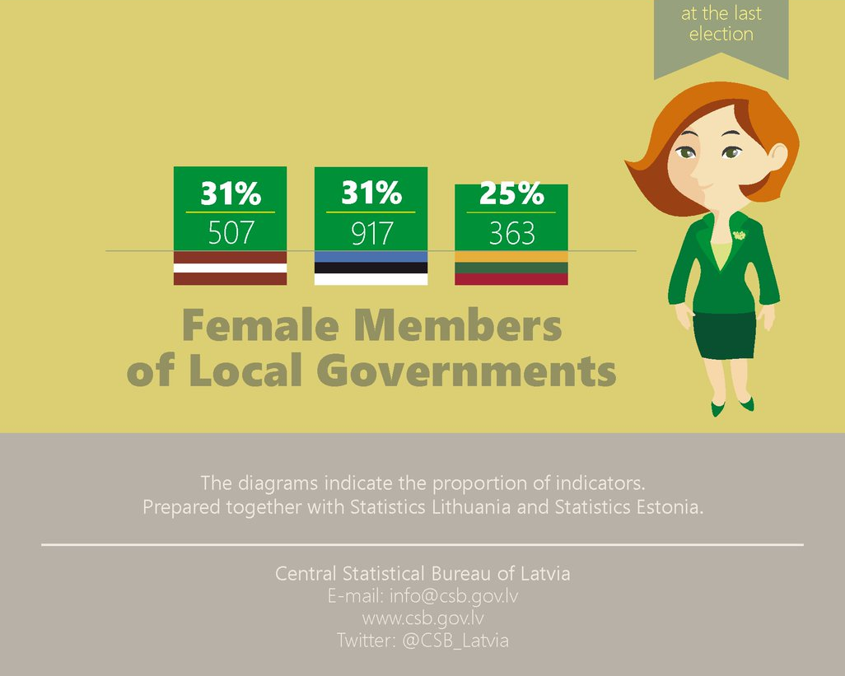
Dissemination and use of gender statistics
Effective communication plans to stakeholders and users of gender statistics
Developed data dissemination platforms (web based, infographics, video, etc.)
  Easily accessible, well understood
Promotion of the user – producer dialogue on user needs
Statistical literacy

Slide 11
Thank you!

