Slide 1
Participation in and access of women and girls to the media, and information and communications technologies
Elke Ferner
Parliamentary State Secretary
German Federal Ministry for Family Affairs, Senior Citizens, Women and Youth

Slide 2
Outline
The gender digital gap
The initiative #eSkills4Girls within the framework of the German G20 Presidency
Women in culture and in the media
Measures against digital violence
→ Discover Football

Slide 3
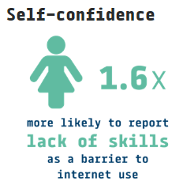
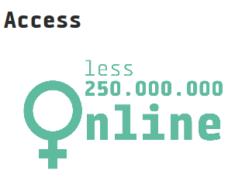
Gender digital gap – worldwide

Slide 4


Gender digital gap– Germany
NON-WEB USERS
'I can live quite well without the Internet.'
MINIMAL WEB USERS
'Online shopping and online
payment is something I never do.'
THIS STATEMENT APPLIES
'I know how to instal devices like printers or scanners.'
45 %
64 %
59 %
71 %

Slide 5


Gender digital divide under the German G20 Presidency
Digital inclusion of women as a new theme on the international agenda
Making female role models from the digital sector clearly visible
Online platform to share knowledge

Slide 6
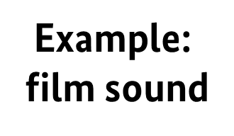
Women in culture and in media
Key positions in the film industry
Women
Men
Mixed Teams

Slide 7
Women in culture and in the media
Allocation of Funding
Example:
German Federal Film Fund 2016
Women
Men

Slide 8
Women in culture and in media
comparison:
vocational training & professional activity
trained experts
48 %
working persons
23%
example:
film script
trained experts
52 %
working persons
60 %
Women
Men

Slide 9




Women in culture and in media

Slide 10


Measures against digital violence
Cyber violence =
violence against women in the real world continued in the virtual world

Slide 11

DISCOVER FOOTBALL
With Women‘s Football for Women‘s Rights - Worldwide

Slide 12
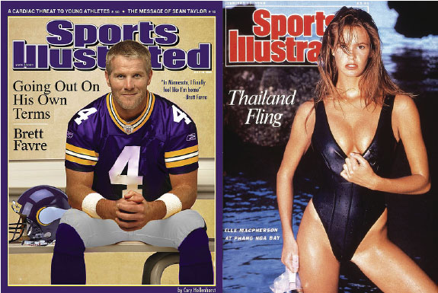
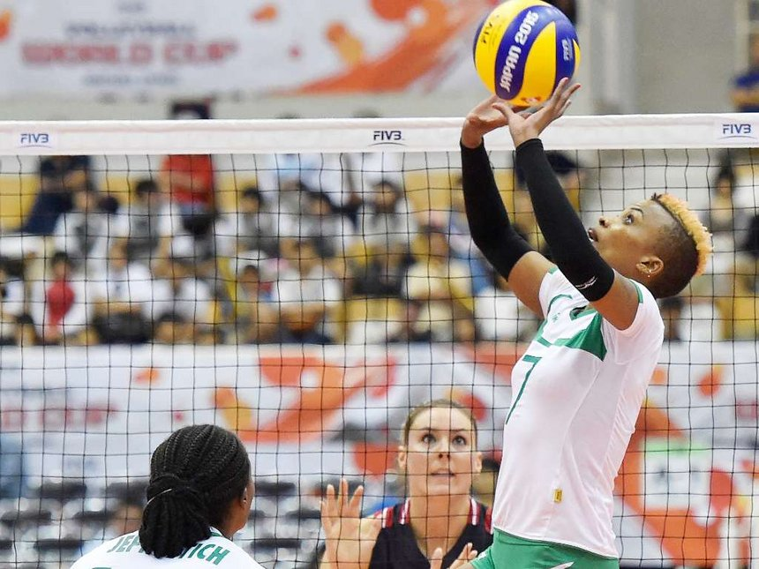


Slide 13

Reactions on Twitter to Claudia Neumann
commentating the game Italy against Sweden at the UEFA men’s Euros 2016 in the German TV:
“Why is a women commentating the game? I’ll get cancer in my ears.”
“With a woman commentating I will fall asleep! What a bad idea!”

Slide 14
Reactions on Twitter to Claudia Neumann
commentating the game Italy against Sweden at the UEFA men’s Euros 2016 in the German TV:
“Why is a women commentating the game? I’ll get cancer in my ears.”
24%
7%
“With a woman commentating I will fall asleep! What a bad idea!”

Slide 15
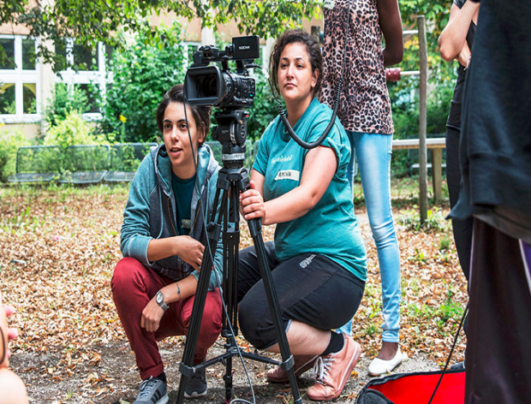
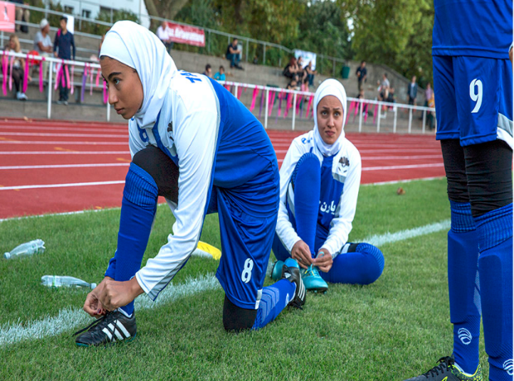
Why Gender Equality in Sports Coverage Matters
mainstreaming pictures and stories about women in sports
creating counter narratives and challenging stereotypes
gaining more popularity for sports practiced by women
motivating more women and girls to do sports
claiming sport as a space for women and girls

Slide 16
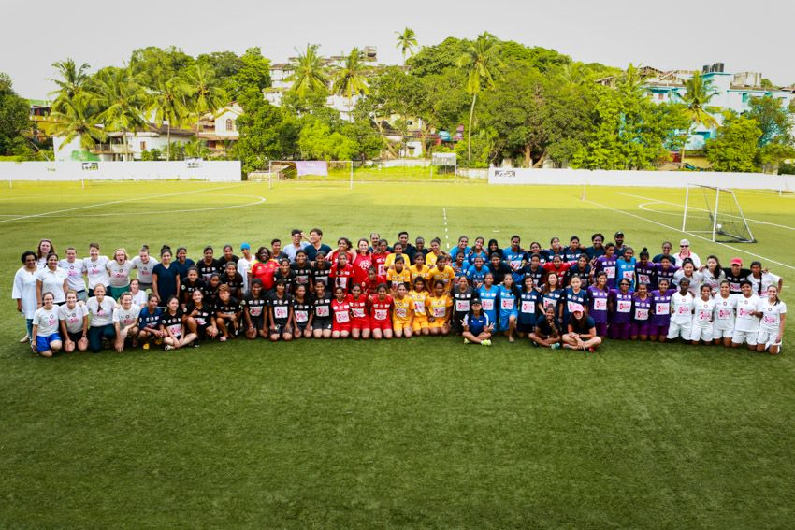
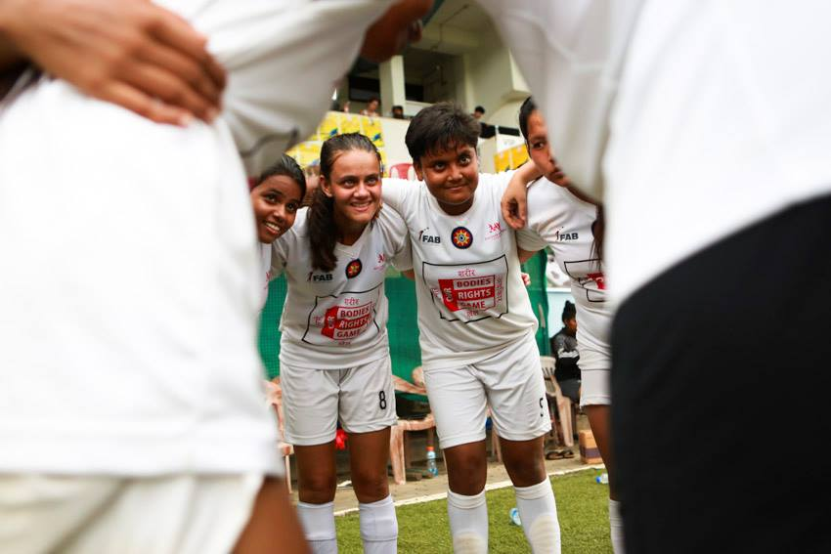
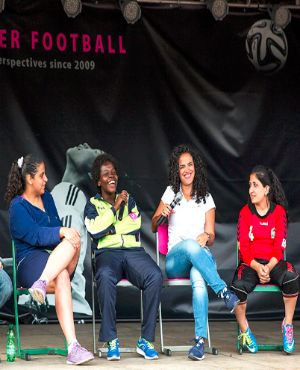
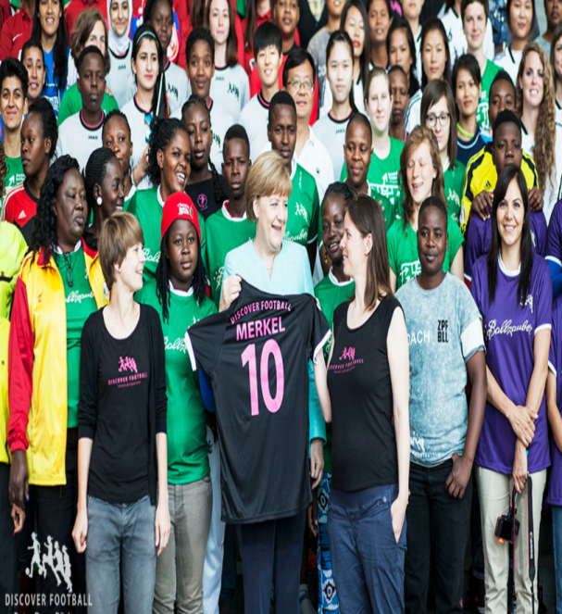
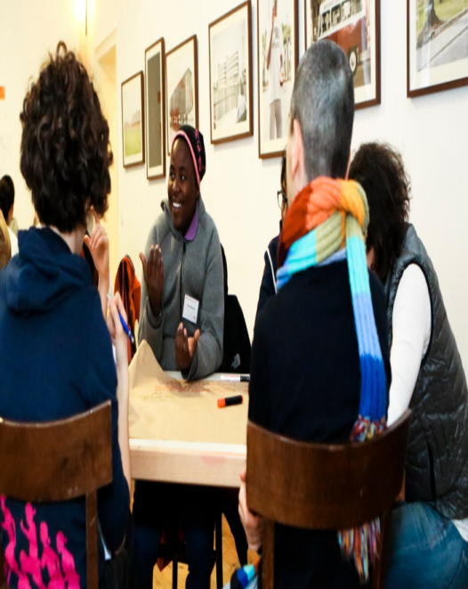
The DISCOVER FOOTBALL Approach:
Football as a Special Tool
Festivals, conferences, seminars on football, sports & gender equality
Linking experiences in sports to broader structures in society
Empowerment through recognition and visibility as experts
Working on strategies, policies and advocacy campaigns
Building a global network

Slide 17
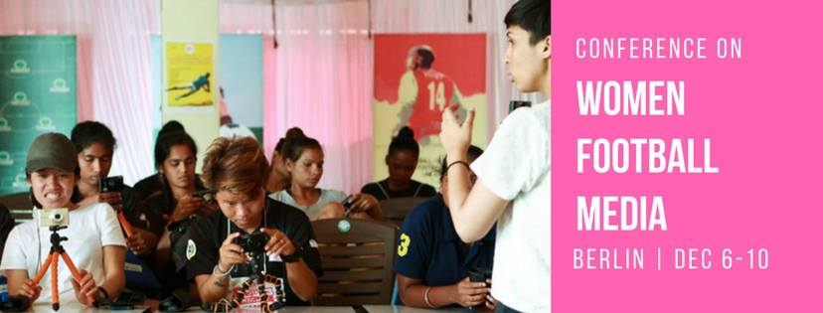
Towards Gender Just Sports Media
Educating, empowering and connecting female sports journalists, sportspersons and media people
Media partnerships with German media outlets
Developing strategies to
  advance female journalists in sports media
  improve the quality of coverage of women in sports
Building a
Global Alliance against Sexism in Sports Media

Slide 18
Thank you for your attention!
Elke Ferner
Parliamentary State Secretary
German Federal Ministry for Family Affairs, Senior Citizens, Women and Youth
Esther Franke
Organization Developer, www.discoverfootball.de
Facebook: Discover Football @DiscovFootball

