Slide 1


WOMEN DIGITAL INCLUSION
SMEs and Entrepreneurs Secretariat

Slide 2
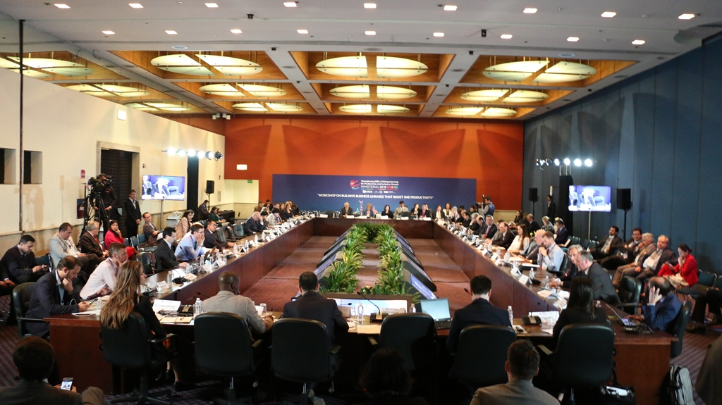
“ENCOURAGING ENTREPENEURS AND SMES IS THE KEY TO ACHIEVE AN INCLUSIVE DEVELOPMENT, ESPECIALLY WHEN THE DIGITAL ECONOMY IS CHANGING ITS CHALLENGES AND OPPORTUNITIES”
OECD Ministerial Conference on SMEs

Slide 3
ARGENTINA DIGITAL TRANSFORMATION
WHAT ARE WE DOING
LEGAL FRAMEWORK: ENTREPENEURS ACT, SMES ACT, SOFTWARE ACT AND BIOTECHNOLOGY ACT.
SIMPLIFICATION OF PROCESSES AND LESS BUREAUCRACY
ENTREPRENEURIAL AND DIGITAL SKILLS DEVELOPMENT THROUGH PLAN 111 MIL AND ARGENTINE ENTREPRENEURS ACADEMY
SMES DIGITAL TRANSFORMATION
PROMOTION OF ENTREPRENEURIAL AND TECHNOLOGICAL ECOSYSTEMS
ACCESS TO GLOBAL MARKETS THROUGH DIGITAL TOOLS

Slide 4

WOMEN DIGITAL INCLUSION
PLAN 111 MIL
+62 MIL
ENROLLED
+22 MIL
WOMEN
COURSED
16.114
MEN
8.490
WOMEN

Slide 5
WOMEN DIGITAL INCLUSION
PLAN 111 MIL
DESERTION CAUSE
Course content problems
Incompatibility with other educational activities
Incompatibility with job
Incompatibility with family responsibilities
Distance between home and headquarters
44,4%
COMPLETED
THE COURSE
55,6%
HAVE NOT COMPLETED
THE COURSE

Slide 6
WOMEN DIGITAL INCLUSION
PLAN 111 MIL
566
CERTIFIED STUDENTS
103
WOMEN

Slide 7
WOMEN DIGITAL INCLUSION
ACTIONS
COMMUNICATION
Marketing campaign
Advertising tv spots
LOYALTY
Visits to Plan 111 Mil courses
#MUJERES111MIL event
MONITORING
Plan 111 Mil registered women survey
Teachers gender perspective survey
GLOBAL POSITIONING
G20
W20

Slide 8




WOMEN DIGITAL INCLUSION
COMPARATIVE
COMPLETED
CERTIFIED
10 MEN
10 MEN
5 WOMEN
2 WOMEN

Slide 9
THANK YOU!
@helena_estrada
SMEs and Entrepreneurs Secretariat

