Slide 1
Permanent Mission of the Republic of Bulgaria to the United Nations
Voluntary presentation on Review Theme - CSW 60 Agreed Conclusions:
“Women’s empowerment and the link to sustainable development”
13 March 2019
United Nations
New York

Slide 2
CSW 60 Agreed Conclusions: “Women’s empowerment and the link to sustainable development”
Content:
1. Strengthening normative, legal and policy frameworks;
2. Fostering enabling environments for financing gender equality and women’s empowerment;
3. Strengthening women’s leadership and full and equal participation;
4. Data Collection;
5. Enhancing National Institutional Arrangements.

Slide 3
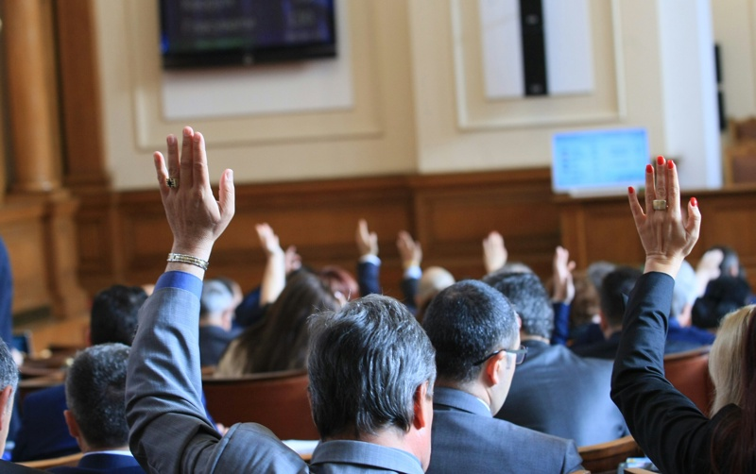
General Overview – The Bulgarian Case
Gender equality in law and in practice – a fundamental principle enshrined in the Constitution of Bulgaria
Women and men in Bulgaria enjoy equal rights
All national legislation and government policies contain anti-discriminatory regulations
Agenda 2030 => Gender equality

Slide 4
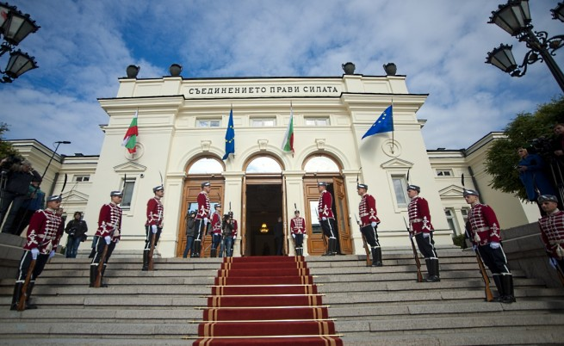
1. Strengthening normative, legal and policy frameworks
Bulgaria’s Penal Code Amendments on Domestic Violence – recently adopted in February 2019
Law on Gender Equality - adopted in 2016
Law on Protection against Discrimination and Law on Protection against Domestic Violence - adopted in 2005

Slide 5
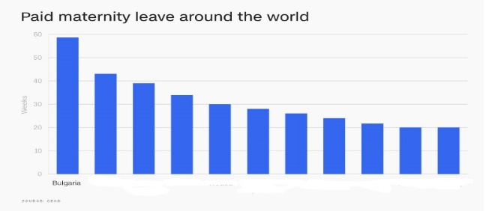
2. Fostering enabling environments for financing gender equality and women’s empowerment
Policies - examples
Two-year maternity leave for mothers - among the longest in the world
National Strategy for Fostering Gender Equality (2018-2022)
Introducing parental leave for fathers
Fostering enabling environments
The Commission on protection against discrimination
The Law on Gender Equality regulates the position of the so called ‘women and men equality coordinators’ since 2016
*OECD information from January 2018

Slide 6
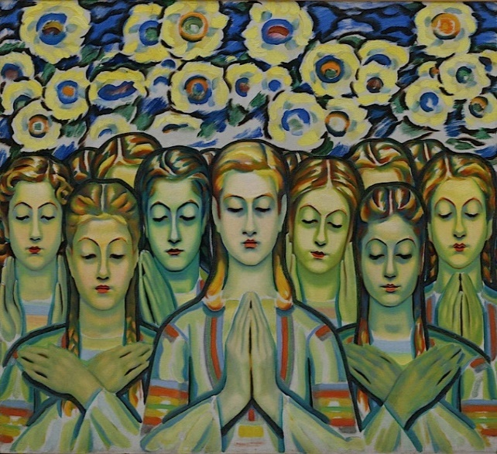
3. Strengthening women’s leadership and full and equal participation in decision-making
Knowledge is power
Bulgaria scores 1st in the EU > 50% of scientists are women
Bulgaria ranks 1st in ICT professionals (30%) who are women
Education is power
Bulgaria ranks 1st in the EU in IT students and engineers
who are women
Bulgarian women in power
The President of the National Assembly is a woman
Two Deputy Prime Ministers and six Ministers are women
The Interim President of the World Bank is a Bulgarian woman
The Vice President of Bulgaria, the Mayor of Sofia, the Ombudsperson are women
All Bulgarian Commissioners to the EU are women

Slide 7
4. Enhancing National Institutional Arrangements
Ministry of Labour and Social Policy - coordinating the national policy on gender equality
National Council on Equality between Women and Men - consultative body to the Council of Ministers of Bulgaria (2004)
National Coordination Mechanism on Human Rights
Ombudsperson
and
Civil society partnership is key > Protection against Domestic Violence

Slide 8
Thank you.

