Slide 1
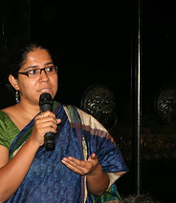
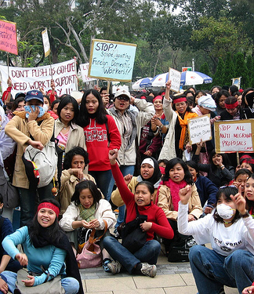




Progress made on the United Nations Entity for Gender Equality and the Empowerment of Women strategic plan, 2014-2017, including operational activities in 2014
Report of the Under-Secretary-General/Executive Director
Planning and Programme Guidance Unit, PPGU

Slide 2
Following from Board Decision
The progress report of the Under-Secretary-General/Executive Director of the United Nations Entity for Gender Equality and the Empowerment of Women (UN-Women) on the strategic plan, 2014-2017, is presented for consideration to the Executive Board, in accordance with paragraph 6 of its decision 2013/5, of 18 September 2013, and includes a report on operational activities in 2014, as requested by the Board in its decision 2014/1.
Demonstrate

Slide 3
Elements of a decision
Elements of a decision. The Executive Board may wish to:
• Welcome the report and the achievements made in the implementation of the Strategic Plan, including its improved results reporting;
• Stress the urgency of increased funding for UN- Women to enable the Entity to fully and effectively implement the Strategic Plan 2014-2017;
• Decide to transmit the report to the Economic and Social Council.
Demonstrate

Slide 4
Background
First year of reporting against the new 2014-17 Strategic Plan
All UN-Women field offices also started new country level plans in 2014, aligned with the new Strategic Plan.
Significant reduction in size of this year’s report (from 12,500 words last year to 8,500 words this year). This is at the direction of the Department for General Assembly and Conference Management (DGACM).
The report and its data companion (data annexes) also incorporates reporting against the QCPR, particularly in relation to capacity development and south-south and triangular cooperation.
Demonstrate

Slide 5
Timeline
3rd regular meeting of Executive Board in 2013 - Approval of the Strategic Plan 2014-17.
November 2103 – New and revised UN-Women country level programmes developed to align with new Strategic Plan
Jan 1st 2014 – launch of new Strategic Plan 2014-17
3rd quarter of 2014 – construction of new results management system begins
December 2014 – launch of Phase One of new Results Management System – field offices start reporting
February 2015 – Field Offices complete results reports
March-April 2015 – Analysis and development of corporate annual report
May 5th – Submission of draft report to the DGACM.
May 31st – Completion of data companion
Early June - All documents available on the Executive Board website.

Slide 6
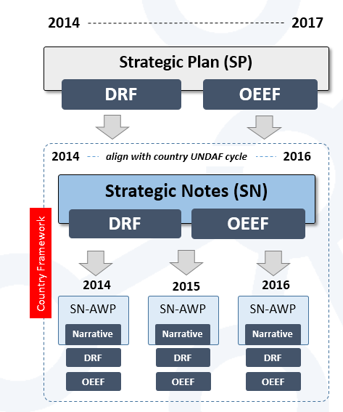
Results Structure

Slide 7
New Results Management System
In order to strengthen results management in UN-Women and improve the quality of performance assessment and results reporting, UN-Women started development of a new results management system (RMS) in 2015.
Development of the RMS will have several phases (agile and iterative development) and be a tool for the follow-up (monitoring) of the execution of programmes and provide an information and decision-making tool with relevant budgetary and financial information on an on-going basis.
Allows the development of qualitative data on cross-cutting areas such as youth, work with men and boys, couth-south, capacity development, innovation etc.

Slide 8
Data Verification
All offices link their results (from their country programmes) with Strategic Plan results from the DRF and OEEF.
They then ‘inherit’ and report on the indicators for that part of the Strategic Plan.
Data is entered by the staff member closest to the work. This is checked and quality assured by the M&E focal point in the office and senior management in the office.
It is then checked again and quality assured by the Regional Office.
Data is then reviewed and any identified issues are addressed by HQ staff.
Before submission, the report and all data and sent back to the field for final validation.

Slide 9
Structure of the report
I. Introduction
II. Global and Normative context
III. Programme results
      A. Overview
      B. Women’s leadership and participation
      C. Increased access for women to economic empowerment opportunities
      D. Ending violence against women and girls
      E. Women’s increased leadership in peace and security and humanitarian response
      F. Strengthening the responsiveness of plans and budgets to gender equality
      IV. Coordination
V. Organizational Effectiveness and Efficiency
VI. Financial Results: Income and expenditure

Slide 10
Global and Normative Context
Represents UN-Women reporting against Impact Area 6 of the Development Results Framework of the Strategic Plan.
Linking normative and operational work.
The Commission on the Status of Women (CSW).
Normative Support to the 69th UNGA.
Financing for development (FFD) and the development of the sustainable development goals (SDGs)
Review of the implementation of the Beijing Declaration and Platform for Action.
CEDAW/UPR

Slide 11
Programme Results
Represents UN-Women reporting against Impact Areas 1-5 of the Development Results Framework of the Strategic Plan.
Six sections
      Overview
      B. Women’s leadership and participation
      C. Increased access for women to economic empowerment opportunities
      D. Ending violence against women and girls
      E. Women’s increased leadership in peace and security and humanitarian response
      F. Strengthening the responsiveness of plans and budgets to gender equality
Also includes content on the Fund for Gender Equality and the United Nations Trust Fund in Support of Actions to Eliminate Violence against Women.
Also includes graphic representation (trajectory charts) for each of the Strategic Plan Outcome Indicators for Impact areas 1-5.
Other indicators are included in the Data companion.

Slide 12
Organizational Effectiveness and Efficiency
Represents UN-Women reporting against the Organizational Effectiveness and Efficiency Framework (OEEF) of the Strategic Plan.
Six sections
      A. Partnerships, communications, advocacy and cross cutting approaches
      B. Data and statistics
      C. Capacity development and south-south cooperation
      D. Results-based management (RBM), reporting and evaluation
      E. Mobilizing and leveraging adequate resources
Also includes content on ICT and innovation, and the Multilateral Organization Performance Assessment Network (MOPAN).
OEEF indicators are included in the Data companion.
Please note that with 118 indicators in total in the results frameworks of the Strategic Plan, it is not possible to report on each one individually within the 8,500 word limit. As such, all 118 indicators are reported on in the Data Companion.

Slide 13
Data Companion
A supplementary document posted on the Executive Board website to accompany the report.
Six sections (current draft)
      Global Overview
      Impact Area 1
      Impact Area 2
      Impact Area 3
      Impact Area 4
      Impact Area 5
      Impact Area 6
      UN-Women Programme Expenses
      UN-Women Resource Mobilization
      Organizational Effectiveness and Efficiency Framework
Please note that with 118 indicators in total in the results frameworks of the Strategic Plan, it is not possible to report on each one individually within the 8,500 word limit of the report. As such, all 118 indicators are reported on here in the Data Companion.

Slide 14
Challenges
Covering a broad spectrum of actions across the UN-Women mandate in under 8,500 words.
Getting the balance right between the presentation of data and the presentation of results stories and examples of progress/success.
Capturing multi-year progress in just the first year of the new Strategic Plan and with all new country programmes.
New indicators in the SP - some of which were very challenging methodologically or proved unworkable.
Normal challenges in presenting contribution to results rather than attribution.
Overall number of indicators (118) with data sources across dozens of offices and programme presences, created vast amount of complex data. This presents challenges with regard to internal capacity.
The new RMS also created an unprecedented amount of qualitative data that can inform decision-making and performance management, but analysis is time-intensive and requires investment.

Slide 15
Opportunities
The organization is in a strong position now to undertake a substantial and useful MTR exercise.
The roll-out of the new corporate results management system has been a success and with investment, has the potential to greatly benefit the organization.
The new data being captured by the RMS should enable even better evaluations of UN-Women’s work in future years.
Future UN-Women reports should be able to present more detailed performance analysis across impact areas and regions, subject to investment in capacity for analysis.

Slide 16
End of presentation
Thank you

