Slide 1

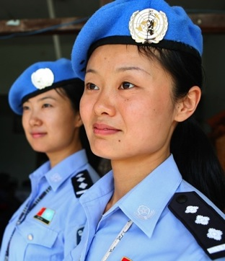

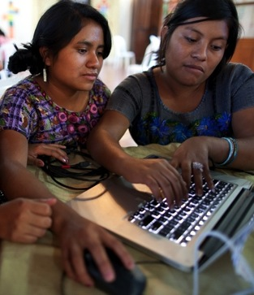


Review of UN Women’s Evaluation Policy

Slide 2
Review of evaluation policy to take decision on its potential revision
Triggers
Existing Evaluation Policy calls for the review
GEAC recommendation based on the three external assessments (UNEG, MOPAN, JIU), related Decision of the Executive Board & agreement of Management response

Slide 3
Process
Co-led by Executive Director Office and IEO
In consultation with EB, Global Evaluation Advisory Committee (GEAC) and UN Women Leadership
2014
UNEG Peer review; JIU assessment; OIOS assessment; MOPAN assessment
June-December 2015
2015 OIOS assessment, GEAC Letter to ED
March-Nov 2015
Round of consultations with Senior Leadership
February 2015
GEAC’s assessment presented to EB;
EB decision
Feb-Mar 2016
Informal consultations with EB
June 2016
Formal presentation findings to EB

Slide 4
1. The evaluation policy establishes an evaluation function that is aligned with international norms and standards
UNEG determined the evaluation function is “sound” and pointed out that the practices of its staff are aligned with UNEG Norms and Standards, and no ethical violations were found
2015 OIOS assessed UN Women evaluation function as the second best out of 31
MOPAN assessed the evaluation function as having “a strong structure, planning systems, and an operational framework geared to promote accountability and learning at both corporate and decentralized levels” and noted that UN-Women has “strong evaluation practices”

Slide 5
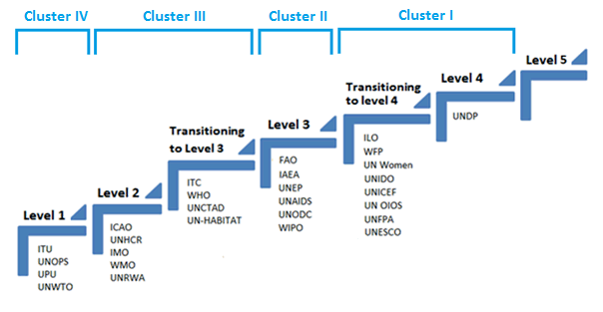
The UNW corporate evaluation function ranked within the highest cluster (Cluster I)
JIU Report
DECENTRALIZED EVALUATION:
UN Women was amongst the 4 leading entities (UNICEF, UNDP, ILO & UN Women)

Slide 6
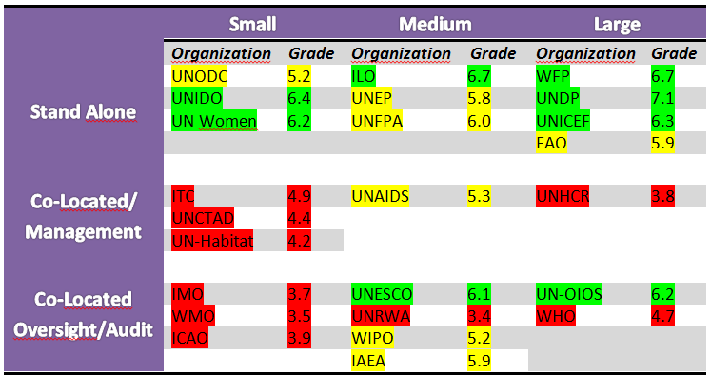
UN Women ranked second highest out of 9 small entities
JIU Report
Level of development of the evaluation function by size of the organizations' overall annual budgets and the location of the corporate evaluation function
Notes:
Source: JIU, page 15

Slide 7
2. The evaluation policy establishes an adequate level of independence of the evaluation function given the organization’s current stage of development
All three assessments concluded that the current level of independence of UN Women evaluation function is adequate given UN Women’s stages of development.
UN Women was ranked in the second highest category on overall independence by JIU compared with other UN entities.
However, UNEG Peer Review was of the view that, in time, the evaluation policy should be revised to strengthen its independence even further.

Slide 8
3. The evaluation policy provides a clear framework for a strong evaluation function
“Comprehensive framework” that is “robust, coherent and consistent” with management principles and aligned with UNEG norms and standards
Evaluations managed by UN-Women are credible and the overall quality was ranked by JIU as higher than the average as compared with other UN entities
Use of evaluation “sound” overall and making positive contributions to ensuring utility of evaluations

Slide 9
4. The evaluation policy reinforces UN Women’s coordination role in UN system with respect to gender responsive evaluation
UN-Women has demonstrated leadership, promoting gender responsive evaluation through coordination efforts within the UN system, including at the country level
JIU recognized the efforts of UN-Women as driving the gender responsive evaluation agenda through “persistent engagement” and noted the leading role in promoting gender

Slide 10
5. Inclusion of National Evaluation Capacity Development is reflective of the current global development context
UN-Women was one of three UN entities out of 24 assessed by JIU that had incorporated national evaluation capacity development into its evaluation policy and evaluation strategy
JIU and UNEG Peer Review urged UN-Women to continue its efforts in strengthening national evaluation capacity development

Slide 11
GEAC and EB assessment on evaluation function
GEAC confirmed most of the findings: UN Women has a “strong central evaluation office and IEO performs well against evaluation standards of independence, credibility and utility, and in comparison with other UN organizations”.
EB “Commends UN-Women for the establishment of a strong enabling environment for evaluation; the strong performance of the Independent Evaluation Office based on the standards of independence, credibility and utility; the leadership by UN-Women in promoting gender equality and responsive evaluation through coordination efforts within the UN system and partnerships, including at country level; and in fostering innovative partnerships for national evaluation capacity development”
2015 December GEAC letter to Executive Director states GEAC is “extremely impressed by IEO accomplishments, which are exceptional”

Slide 12
Consultation with UN Women Senior Leadership
A consultation with UN Women Senior Leadership identified that, based on the positive assessments by external entities, GEAC and Executive Board, a revision of the Evaluation Policy is not necessary this time.
Current evaluation policy proves to be adequate for governing the UN Women evaluation function. External assessments agree evaluation function is robust.
As a general practice in the UN system, evaluation policies are reviewed every five years or more to fully understand the impact and results of these policies. The current Evaluation Policy came into force only in 2013, and therefore to revise it after three years would be too early.

Slide 13
Overall conclusion and recommendation
Given the overall positive assessment of UN Women evaluation function and the fact that the policy has been in place for three years only, it is recommended that a revision of the UN Women evaluation policy be considered in five years time, based on the recommendation of a new review to be conducted the prior year.

